Slide 1
Leadership
Plentiful Job Opportunities
Career Advancement
Careers banking
in
Challenging Work
Community Service
Notes:
Banking Industry:
These are topics we’ll discuss today through this presentation and how our personal experiences and career paths have led to opportunities in these areas.

Slide 2
Banks Employ Two Million People
25%
Tellers
41%
Administrative and
Branch Operations
34%
Corporate and Management
Source: Bureau of Labor Statistics, 2013
Notes:
The banking industry employs more than 2 million people nationwide.
About two-thirds work in branches as tellers, loan officers and administrators. But as you can see, tellers—who as the public face of banks serve a very important role—make up one quarter of all banking jobs.

Slide 3
Banker Name
Background
[insert info]
What I Look for in an Employer
[insert info]
Notes:
Copy slides 3-5 for multiple bankers making presentation! Insert your bank’s logo and other photos you’d like you use on slides 3-5.
Background – where you grew up, education
What you look for in an employer:

Slide 4
About My Bank
When?
[insert info about background/history of your bank]
Who?
[insert info about bank leadership, president/CEO, board, etc.]
Notes:
Copy slides 3-5 for multiple bankers making presentation! Insert your bank’s logo and other photos you’d like you use on slides 3-5.
About your bank:
When it was founded
In your opinion, what makes your bank unique (culture, customers, leadership, etc.)
Core Values:

Slide 5
Banker Name
Banking Experience
[insert info]
Experiences as a Result of my Career in Banking
[insert info]
Notes:
Copy slides 3-5 for multiple bankers making presentation! Insert your bank’s logo and other photos you’d like you use on slides 3-5.
Banking experience – how long you’ve been at the bank/in banking, different roles you’ve had in the industry
Experiences as a result of your career in banking

Slide 6
Innovative
Service Business
Perks of Being a banker
Educational
Community Service
Notes:
Banking Industry:
■ Provides a wide range of job opportunities and experiences;
■ Encourages on-the-job training
■ Challenges you to solve problems and help others manage their finances; and
■ Offers opportunities for leadership and community service.
■ Competitive compensation and good benefits

Slide 7
Banking is Educational
Multiple Career Paths
Professional Certifications
Extensive Trade Association Support and Resources Available to You
Continuing Education
VBA Management
Development Program
VBAConnect
VBA School of Bank Management
Notes:
Possible talking points:
Helping bankers develop their careers and enhance their profession is a long-established tradition. Banks offer training and encourage employees to further their educations.
Employees can advance their careers through trade associations like the American Bankers Association and the VBA.

Slide 8
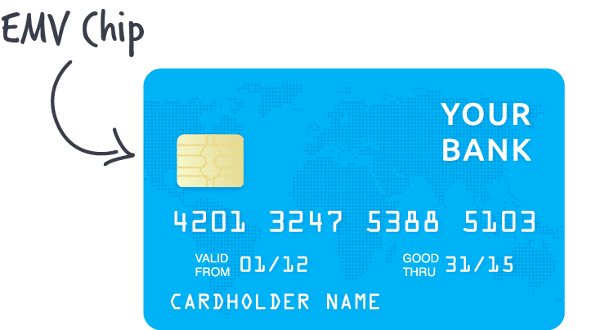
Banking is Innovative
Banking has a history of innovation – mobile banking, ATMs, online bill pay, credit and debit cards
These inventions have helped make consumers’ lives simpler and safer
New technology requires banks to add jobs to create and support mobile banking platforms, ATMs, and secure computer networks
Notes:
Banking is innovative.
Look at services such as mobile banking and online banking, which developed with the popularity of cell phones and the ubiquity of the Internet.
Talk about ways your bank has embraced mobile/online banking
Bankers can make change and embrace change.

Slide 9
Banking is a Service Business
We help people and businesses manage their money and use credit carefully
We help people buy a home or start a business
We help our community grow
Notes:
What do bankers and banks do? We help people and businesses manage their money and to carefully use credit to achieve their dreams. That can include buying a home, saving for retirement or starting up a business. These activities and others help our community grow.

Slide 10
Best Perk of Being a Banker: Giving Back to Your Community
Working on community events through sponsorships and volunteerism
Providing loans and opportunity to small businesses
Being a resource to your customers
Connecting people
Notes:
Add pictures of your bank involved in community events here.
In addition to helping our customers and community grow and prosper, like all banks do, we encourage our employees to give back through volunteer community service. Here are some examples…

Slide 11
The Outlook: We’re Hiring
According to the Bureau of Labor Statistics, bank employment is projected to grow through the remainder of this decade.
One major growth area is compliance
Notes:
Possible talking points:
The outlook for bank employment remains promising. According to the Bureau of Labor Statistics, bank employment is projected to grow through the remainder of this decade.
Key drivers of this growth include increased regulatory compliance demands. Virtually every interaction we have with customers is guided by banking laws and their implementing regulations. These rules are enforced by regulators including the Federal Deposit Insurance Corp, the Office of the Comptroller of the Currency, the Federal Reserve, the Consumer Financial Protection Bureau and state regulatory agencies. That means banks must comply with thousands of pages of rules—many of which are new and affect entire segments of our lending business. Mortgage lending is one example. Bank compliance officers ensure that their institutions are following banking laws and regulations.

Slide 12
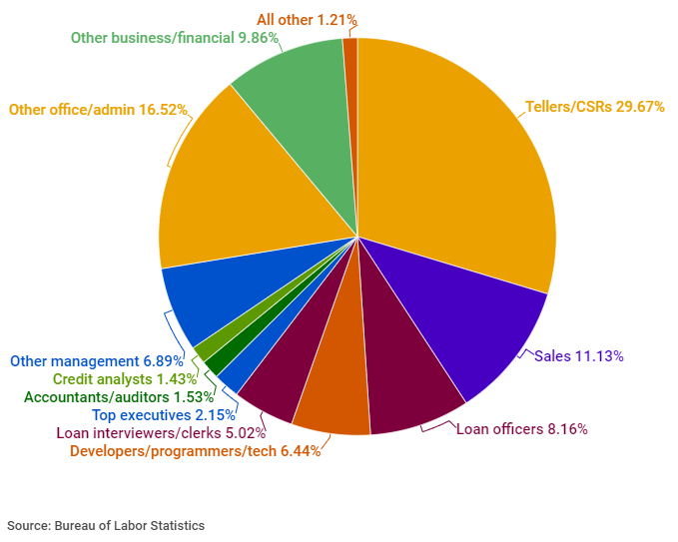
Career Opportunities at America’s Banks
Notes:
Possible talking points:
In addition to tellers, bank offer a variety of positions in such areas as compliance, business banking, public relations and marketing, accounting, human resources, IT and investment banking. A banker isn’t just a teller or a lender, he could be a computer network technician, an attorney or an economist.

Slide 13
Diverse Job Opportunities
customer sales representative
computer network technician
electronic banking officer
economist
human resources manager
attorney
agricultural lender
accountant
marketing manager
teller
Commercial loan officer
Compliance officer
Notes:
Possible talking points:
In addition to tellers, bank offer a variety of positions in such areas as compliance, business banking, public relations and marketing, accounting, human resources, IT and investment banking. A banker isn’t just a teller or a lender, he could be a computer network technician, an attorney or an economist.

Slide 14
Explore the Opportunities
Careers banking
in
Notes:
Take a closer look at the many opportunities in banking. We’re glad we did. Let’s go to your questions now.

