Slide 1
Virginia Bankers Association Legal Affairs Committee
J.P. McGuire Boyd, Jr. (mboyd@williamsmullen.com)

Slide 2
Wire Fraud
Conductive Techs., Inc. v. PNC Bank, 2024 WL 3035184 (M.D. Pa. June 17, 2024)
Conductive Technologies, Inc. (“CTI”) employee inadvertently gave online banking access to unknown criminal actor resulting in fourteen (14) fraudulent wires totaling approximately $3.5 million.
CTI sued PNC Bank for breach of contract for failing to: (1) obtain secondary authentication for wire requests; and (2) detect and notify CTI of suspicious wires.
Court granted motion to dismiss finding: (1) services agreement disclaimed bank’s responsibility to discover unauthorized disclosure or use of security procedures; (2) bank had no duty to monitor or notify customer of suspicious transactions; (3) bank had no duty to obtain secondary authorization for wires.

Slide 3
Check Fraud
C&C Metal Recycling, LLC v. First-Citizens Bank & Tr. Co., 2024 WL 3047558 (D.S.C. June 18, 2024)
C&C Metal Recycling, LLC (“C&C”) sued First Citizens Bank after it paid two counterfeit checks.
First Citizens moved to dismiss arguing both checks were properly payable under “reverse positive pay” terms of parties’ agreement.
Court overruled motion to dismiss for two reasons: (1) C&C challenged authenticity of agreement version that First Citizens presented; (2) no evidence showed that C&C ever enrolled in reverse positive pay service.

Slide 4
EFT Fraud
“‘Unauthorized electronic fund transfer’ means an electronic fund transfer from a consumer’s account initiated by a person other than the consumer without actual authority to initiate the transfer and from which the consumer receives no benefit. The term does not include an electronic fund transfer initiated: [b]y a person who was furnished the access device to the consumer’s account by the consumer[.]” 12 C.F.R. § 1005.2(m).
“‘Access device’ means a card, code, or other means of access to a consumer’s account, or any combination thereof, that may be used by the consumer to initiate electronic fund transfers.” 12 C.F.R. § 1005.2(a)(1).
“An unauthorized EFT includes a transfer initiated by a person who obtained the access device from the consumer through fraud or robbery.” 12 C.F.R. § Pt. 1005, Supp. I.

Slide 5
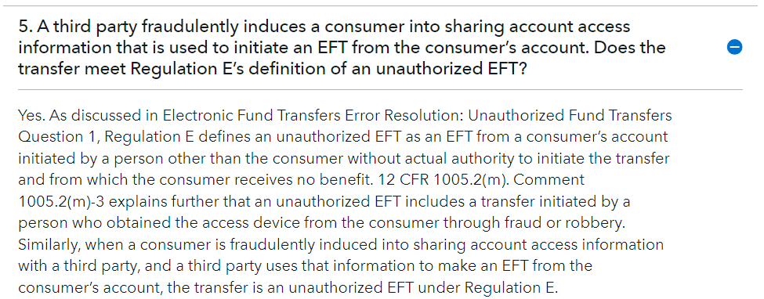
EFT Fraud (cont.)
https://www.consumerfinance.gov/compliance/compliance-resources/deposit-accounts-resources/electronic-fund-transfers/electronic-fund-transfers-faqs/

Slide 6
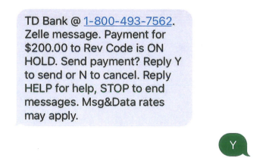
EFT Fraud (cont.)
Nelipa v. TD Bank, N.A., 2024 WL 3017141 (E.D.N.Y. June 17, 2024)
Plaintiffs—victims of imposter scams—sued TD Bank for violating EFTA by refusing to recognize EFTs as unauthorized when customers subsequently confirmed transactions in response to “fraud verification” text messages from TD Bank.

Slide 7
EFT Fraud (cont.)
Nelipa v. TD Bank, N.A., 2024 WL 3017141 (E.D.N.Y. June 17, 2024)
Report and recommendation found that TD Bank had a uniform policy of denying claims of unauthorized transfers where consumer approves via text message.
Predominate question: whether treating text message approvals as dispositive proof of “authorization” is consistent with the EFTA and CFPB’s Official Interpretation.
Predominant question requires resolving: (1) whether CFPB’s Official Interpretation is valid and should be afforded deference; and (2) whether Official Interpretation applies when consumer approves transfers via text message.

