Slide 1
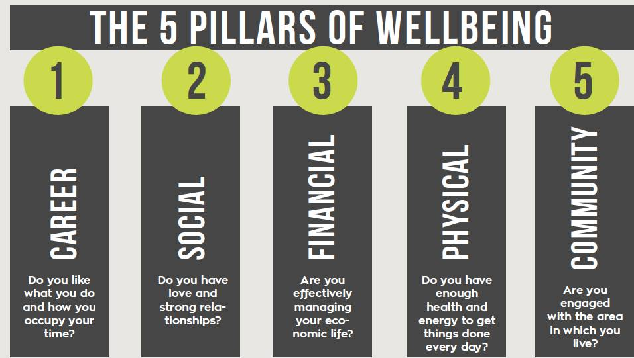
What’s included in a Comprehensive Wellness Program?

Slide 2
Employees are Looking to Employer to be epicenter of Financial Life
Employee Financial Stats
Retirement Industry Response
62% of Americans want access to financial planning tools, but don’t know where to start
65% want a concrete plan to address spending in their retirement years
66% of Americans feel distracted at work due to financial pressures at home
77% of Americans want a more personalized 401(k) experience (advice)
Average 401(k) balance - $66,000
SECURE Act 1.0 & 2.0
Shift from plan design focus to participant education focus
Investment in behavior finance and creating customizable financial wellness solutions
Access to a financial advisor for personalized retirement planning and coaching

Slide 3
VBA Benefits Corporation’s 2024 Retirement (Financial Wellness) Initiatives
Employee’s Financial Wellness
Dedicated SBA Resource
Participant Transition Services
Tools to combine H&W and Retirement decision making (evaluating)
Tailored Education Programs

