Slide 1
VBA Benefits Corp
2024 Well-being Summit
February 7, 2024

Slide 2
Agenda
Health trends
Well-being strategy planning tools
Group discussion
What’s next
Communication tools

Slide 3
The Evolving Workforce
2024 employee health trends

Slide 4



As we continue to figure out post-pandemic work life, care and well-being take center stage
Executive summary
Life post-COVID is much different than it was before 2020. A significant, lasting impact of the pandemic is that employees have raised their expectations for benefits. They are no longer seen as a standard aspect of the employment contract but as something of true value.
Benefits once considered “above and beyond” have become standard practice. Many temporary measures to bolster employee well-being during the pandemic are now expected to continue perpetually.
Care & well-being dominate the conversation
In a post-pandemic world, the role of benefits isn’t
going away.
Benefits are playing
a role like they
never have.
Employee well-being and mental health are now top priorities for employers, and benefits are being enhanced accordingly.^{1,2}
Sources: 1. Gallup, “State of the Global Workplace: 2023 Report,” 2023, Link, 2. Mercer, “Health on demand 2023 survey report,” 2023, Link

Slide 5


Highly energized employees are more likely to work for a company that delivers on total well-being, has tackled organizational complexity, and has an inclusive culture.
Employees who feel energized at work
2019
74%
2022
63%
By gender
By generation
Male employees are more energized (69%) than female employees (57%).
Gen Z are least energized (55%) and Gen Y most energized (65%).
Employees who feel at risk of burnout
2019
63%
2022
81%
By gender
By generation
Drivers of burnout for men are perceived unfairness and lack of a support network; for women, burnout is due to workload and pandemic-era emotional demands.
Most at risk of burnout are Gen Z (89%) and Gen Y (89%), with Gen X below the average of 78% and Baby Boomers significantly lower at 58%.
Source: Mercer, “Health on demand 2023 survey report,” 2023, Link

Slide 6


1
4 generations,
1 workforce
Boomers, Gen X, Millennials, and
Gen Z “live in
different worlds” from one another.
Their unique economic challenges, health care issues, values, and work attitudes shape their benefits expectations.
2
Better benefits, better talent
Benefits are more important than ever according to 95% of employers, and in
some cases on par
in importance with
pay increases.
Customization of benefits is the way of the future.
3
Whole Person Health is here
to stay
Employers see
the value in Whole Person Health.
Employees expect whole person
benefits because
they believe employers are responsible for
their well-being.
Whole Person Health has a positive ROI.
4
Health care costs – the pressure is on
Health care costs
are rising – 5.4% in 2024 alone.
Employees and employers are strained by rising pharmaceutical costs. 1 in 3 employees struggle to afford
their prescriptions.
Employers are turning to transparency and optimization to mitigate frustration.
4
trends
of 2024
All generations report being under-engaged, concerned about cost of living, and in need of improved mental health services.

Slide 7


Slide 8

Overview
Four generations — Boomers, Xers, Millennials and Zers — coexist in today’s workplace.
Employers are tasked with understanding and managing each cohort’s unique expectations and needs, delivering a workplace experience and benefits package that keeps them engaged and validated.
Developing an informed, holistic perspective of what each group wants and why they want it will allow today’s corporate leaders to create an environment where all employees can thrive — regardless of age and outlook.
Marsh McLennan Agency | Employee Health & Benefit Trends 2024 | 8

Slide 9
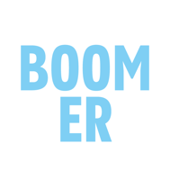



Generations at a Glance
Born¹
1946-1965
1966-1980
1981-1996
1997-2012
Ages¹
77-58
57-43
42-27
26-11
% of global population²
14%
19%
23%
25%
% of U.S. workforce³
18%
31%
36%
15%
Aspirations⁴
Job security
Work-life balance
Freedom and flexibility
Security and stability
Motivated by⁴
Company loyalty, teamwork, duty
Diversity, work-life balance, personal-professional interests over company interests
Responsibility, quality of their manager, unique work experiences
Diversity, personalization, creativity, individuality
Worldview^{4,5}
Achievement comes after paying
one’s dues; sacrifice
for success
Diversity; quick to leave if needs unmet; resistant to change at work if it impacts their personal lives
Seeking growth and development; fun environment; work-life balance; quick to leave if workplace unwilling
to change
Independence, individuality, and diversity; innovative
co-workers; concerned about the future
Communication preference^{5,6}
More formal; in-person or phone call
Informal but direct style; email and
text messages
Frequent and
timely feedback; text/chat messages
In-person preferred; video calls
Sources: 1. Pew Research Center, “The generations defined,” 2019, Link,
2. Statista, “U.S. population share by generation 2022,” 2023, Link,
3. U.S. Bureau of Labor Statistics, 2023, Link, 4. Inc, “Different Motivations for Different Generations of Workers,” 2017, Link, 5. Purdue University Global, “Generational Differences in the Workplace,” 2023, Link,
6. Talentor, “Generation Y in the Workplace,” 2016, Link

Slide 10




Preferred benefits at a glance
Boomers
Gen X
Millennials
Gen Z
Caregiving benefits^{6,7}
Comprehensive health
care plans^{1,4,6,7}
Workplace flexibility⁷
Retirement benefits^{1,4,6}
Wellness benefits
and discounts⁷
Remote work benefits^{2,7}
Flexible scheduling^{2,6}
Caregiving benefits^{2,3,5}
Retirement planning^{2,5}
Flexible scheduling^{1,4}
Remote work benefits^{1,2,4}
Student loan repayment^{2,8}
Financial planning assistance^{2,3}
Ongoing training and development^{1,6,8}
Family leave and
childcare benefits^{1,2}
Fertility benefits³
Comprehensive
health care plans^{1,7}
Holistic health and
well-being benefits, particularly mental
health benefits^{2,6}
Financial planning assistance^{2,7}
Tuition reimbursement^{3,8}
Flexible scheduling^{1,6,7}
Remote work benefits^{1,6,7}
Sources: 1. Obsidian HR, “What Employee Benefits Each Generation Wants,” 2021, Link, 2. Ameritas, “How to Tailor Benefits for a Multi-Generational Workforce,” 2021, Link, 3. MetLife, “The Rise of the Whole Employee: 20 Years of Change in Employer-Employee Dynamics, MetLife’s 20th Annual U.S. Employee Benefit Trends Study 2022,” 2022, Link, 4. AICPA & CIMA, “AICPA Employee Benefits Report,” 2018, Link, 5. DataPath, “Whitepaper: How Has the Pandemic Impacted Employee Benefit Strategies?” 2021, Link, 6. Forbes, “Workplace Benefit Trends By Generation In 2023,” 2023, Link,
7. Ernst & Young, “The 2022 EY US Generation Survey: Addressing diverse workplace preferences,” 2022, Link, 8. HRCI, “The Education Perks Younger Workers Value Most,” 2022, Link

Slide 11




Key themes emerged across generations, shaping their work and benefit needs.
Maintaining flexibility
59% expect remote work flexibility, with 44% ranking it a top 3 factor for an ideal company.¹ When candidates choose between similar compensation offers, flexible work can
often be the deciding factor, regardless of
their generation.²
Lack of engagement
Across generations, 59% report not feeling engaged, and 18% are actively disengaged. This is prompting 51% to feel the need to seek new jobs within the next year.³
Stress and mental health
Across generations, 44% feel constant stress, rising to 68% for Gen Z and younger Millennials.⁵ In a survey conducted by the American Psychological Association, workers reported that their primary workplace stressors were overly heavy workloads, lack of advancement opportunities, low salaries, and exclusion from decision-making.⁶ Stress and burnout affect productivity, retention, and career growth, linking to physical health risks, further emphasizing the need for mental health resources.
Cost of living crisis
Inflation has driven prices up, causing 77% of Americans to worry about finances.⁴ Unlike previous periods of economic instability, this situation has led to more job market mobility as workers seek better pay and benefits to cope with rising costs.
Sources: 1. Oyster, “The Employee Expectations Report 2022,” 2022, Link, 2. McKinsey, “Americans are embracing flexible work—and they want more of it,” 2022, Link, 3. Gallup, “State of the Global Workplace: 2023 Report,” 2023, Link, 4. Capital One and The Decision Lab, “Mind Over Money Study,” 2020, Link, 5. Gallup, “Generation Disconnected: Data on Gen Z in the Workplace,” 2022, Link, 6. Deloitte, “Workplace Burnout Survey,” 2018, Link

Slide 12
Comprehensive health coverage is expected, with varying additional benefits by generation
Boomers
Aging and health concerns increase the value of health care coverage for this group. Some are transitioning to part-time work for a work-life balance but face health care challenges. This makes wellness perks, such as gym membership discounts, appealing.¹
Gen X
Caught between eldercare and parenting, this generation prioritizes caregiving benefits and flexible work for family time. Key needs include caregiver leave policies, disability insurance, financial wellness, and supplemental health offerings, like accident or critical illness insurance.²
Millennials
Millennials, health-conscious but underutilizing preventive care benefits, may encounter future health issues down the road.³ They prefer alternative health options like acupuncture and chiropractic care and view traditional doctors as a last resort.⁴ Currently, they prioritize benefits easing financial burdens, like student loan debt and childcare costs.
Gen Z
They perceive rising health
care costs as a threat to their financial security, underscoring the need for comprehensive health plans. They also seek alternative, customizable holistic health benefits to add to that comprehensive plan.⁵ Given their stress and mental health issues, they prioritize mental health benefits, like workplace therapy, meditation, and mental health days.⁶
Sources: 1. AICPA & CIMA, “AICPA Employee Benefits Report,” 2018, Link, 2. Employee Benefit News, “The case for caregiving policies for Gen X workers,” 2019, Link, 3. BlueCross BlueShield, “The Health of Millennials,” 2019, Link, 4. BlueCross BlueShield, “Millennial Health: Engaging and Empowering a Generation at Work,” 2020, Link, 5. Gravie, “What Gen Z Wants Out of Their Health Benefits,” 2020, Link, 6. SHRM, “Gen Z Expects Mental Wellness Support from Employers,” 2023, Link

Slide 13
Employers are looking beyond Mental Health to consider all the factors influencing their employees’ well-being
The top benefits and perks that employees say would motivate them to apply for a job with another company
59%
Four-day work week
The pandemic-era Mental Health revolution spurred employers to seriously invest in their workers’ mental health.
However, they find that therapeutic and psychiatric intervention fails to address the root causes of employee stress and burnout, such as financial, housing, and food security.
To make a meaningful, lasting impact on overall employee wellness, employers are adopting a broader, whole person approach that considers the myriad contributing factors of health.
401(k) matching
57%
52%
Unlimited PTO
Paid mental health days
46%
35%
Travel benefits
Source: iSolved, “Benefits’ Big Impact on Employee Retention,” 2023, Link

Slide 14





Mental health condition prevalence by generation
Chapter 2
Leveraging MMA’s proprietary analytics platform, we can visualize generational trends.
Millennials have the highest prevalence
of depression, anxiety, and ADHD
Boomers
Gen X
Millennials
Gen Z

Slide 15

Building a Well-being Strategy
Individual Resources to Thrive
Financial
Social
Physical
Mental

Slide 16
Culture & Well-being Strategy
WHY
WHAT
Why implement a total
culture and well-being strategy?
Quality & EE satisfaction
Generate revenue & grow business
Employee engagement & retention
Risk management
HOW
Assess the current state
of health, risk and utilization based on available population data and
identify what focus opportunities exist.
Employee engagement
Utilization
Health status
Leadership values
Health habits
Work environment
Absenteeism
Corporate values & policies
Determine the tactics (programs, resources, and tools) and how to improve culture and well-being.
Raise awareness
Connect to values
Offer choice
Educate
Offer opportunities to practice
Provide coaching
Build support networks
Inspire with rewards
Enable healthy choices through environmental design

Slide 17
Strategy considerations to drive actionable outcomes
Goal: Transform health care data into prescriptive strategies that help each employer offer competitive, cost-effective programs and resources while engaging employees to optimize their health

Slide 18

Developing A Successful Wellbeing Program
Gain consensus and support from senior management and assemble work group
Analyze needs
and gaps
(Comprehensive Assessment)
Invest in appropriate activities and programming
(Implementation)
Measure and evaluate outcomes
(Evaluation)
Develop an
action plan (Strategy)
Successful wellbeing strategies depend on:
Analyzing needs and gaps – credible assessment of where
you are today.
Focused action plans and investment to turn your most critical challenges into opportunities for improved results.
Ability to evaluate outcomes and measure levels of success as well as opportunities for enhancement.

Slide 19





Proposed Wellbeing Strategy
Sample Three Year Timeline
2024
2025
2026
Data Analysis& Risk Assessment
Build the Foundation
Communication& Engagement
Targeted Health Interventions & Goals
Evaluation
Utilize medical plan data and other data collected via PATH analytics to assess risk and identify opportunities for program offerings; consider implementing an employee well-being survey.
Continue to utilize medical plan data, PATH analytics and other data sources collected to modify the program offerings and revise wellbeing program accordingly.
Continue to utilize medical plan data, PATH analytics and other data sources collected to modify the program offerings.
Form an employee wellbeing committee and include a cross representation of all employees within the organization and level; engage senior leadership for support in the program; develop a wellbeing strategy and program design for the next three years.
Utilize data to make decisions about relevant programming and intervention changes. Begin to develop or expand existing policies and guidelines to support employee health and well-being throughout the organization’s culture.
Utilize data to make decisions about relevant programming and interventions. Revise draft and annual wellbeing plan for 2027 based on data available. Use select third-party vendors for carrier programs that are not producing desired results.
Develop a wellbeing brand; leverage current communication channels within the organization and include a plan for hard to reach employees; develop a calendar of events for the year.
Continue to use new well-being brand in connection with well-being committee initiatives and events. If needed, implement an app-based communication platform.
Revise/update annual communications to align with wellbeing interventions.
Determine areas of interest, and identified risks, execute/communicate existing carrier program and consider additional programs delivered by third-party vendors (i.e., prediabetes & disease management, self-blood pressure monitoring, stress relief programs, lunch/learn seminars).
Continue to focus well-being initiatives based on data, survey results, and committee interest.
Continue to focus wellbeing initiatives based on data, survey results, and committee interest.
Determine realistic measure of success for annual activities. Develop a plan to evaluate the effectiveness of current carrier-based and/or vendor-based programs.
Continue to measure success based on sources of data identified. Evaluate the effectiveness of any vendor-based and/or carrier-based programs.
Continue to monitor all well-being programs based on the sources of data identified.

Slide 20
Proposed Wellbeing Strategy
Three Year Timeline
2024
2025
2026
Robust Communication Campaigns (by generation): Include spouses and 15% of members with zero medical claims Importance of preventive exams, physician relationships, and available MH/BH programs, tools, and resources Communication segmentation: Anthem and MMA toolkits Invite Anthem and vendors on site to help promote awareness of available programs, tools, and resources Launch Employee Well-being Survey Campaign: Incent completion Review aggregate results report to help with ongoing strategy planning Determine interest in joining a well-being committee to help plan, support, and promote well-being initiatives Customized well-being program considerations for 2025: Third-party Vendor Point Solutions: WellWorks for You & Asset Health Program design/incentive considerations: Annual physicals Completion of health survey Online activity challenges Participation in a company/community event Annual flu shots Download program/vendor app: separate incentive provided directly by VBA or participating banks Monitor program engagement: Newly launched Weight and Blood Pressure Programs: Noom, WW, Hello Heart, or Anthem Musculoskeletal: Hinge Health Employee and leadership testimonials related to program participation Deploy a comprehensive Mental Health campaign including: Employer Resource Groups Manager training opportunities: MHFA and how to become a more empathic leader Robust generation communication strategy: Leverage Anthem resources: include customized home mailers to reach Spouses and Dependents | Continue communication campaign efforts highlighting areas of focus related to new well-being program launch (where applicable), preventive care, top chronic conditions, members with zero medical claims, and available resources to help improve awareness of available programs and services Leverage available PATH/Artemis medical/Rx data and other aggregate utilization reports for ongoing well-being strategy planning and program enhancement considerations Implement a Mental Health Company Policy – leadership launchs in May (National Mental Health Awareness Month) Consider adding a day of PTO that supports well-being: getting annual physicals, mental health, etc. | Continue communication efforts on available programs, tools, and resources that support employee well-being Consider offering caregiving services (child, elder, and pet care) Evaluate current company policies that support family planning Employee well-being survey (once every two years) and use as an additional strategy planning tool

Slide 21
Health & Well-being Current State Analysis
VBA Benefits Corp- 2024 sample discussion document
Strengths What’s working well? Which programs, resources, and initiatives do employees (and spouses) enjoy? | Weaknesses What approaches are not working well / may need refreshing? What resources are lacking?
Senior leadership & middle management support and buy-in | Engagement – How to draw them in Competing for attention – “People don’t read what is sent to them”
Opportunities What gaps exist in current programs, resources and strategies? | Challenges What factors might inhibit improvement or implementation of expanded resources?
Hinge Health Building a well-being committee (ambassadors) Long term well-being strategy | Costs and budget constraints

Slide 22
What’s next?
Mid-year Wellbeing Summit Check In
May 16th at 1:00 PM
VBA will send invite to attendees
Share at least one new strategy planning
success story

Slide 23
Communication toolkits

Slide 24

Introducing
“When employees feel supported, in all aspects of their lives, it resonates throughout an organization.”
- Dave Eslick, CEO, Marsh McLennan Agency
Your one-stop-shop for well-being resources, education and toolkits. Here you will find fully vetted resources that will help support:
Well-being strategy development
Tools to help build a well-being program
Turnkey employee communication samples
Compliance requirements
Accessing eMMpower:
eMMpowermma.clientportalonline.com
Username: emmpower@zywave.com
Password: MMAemmpower

Slide 25
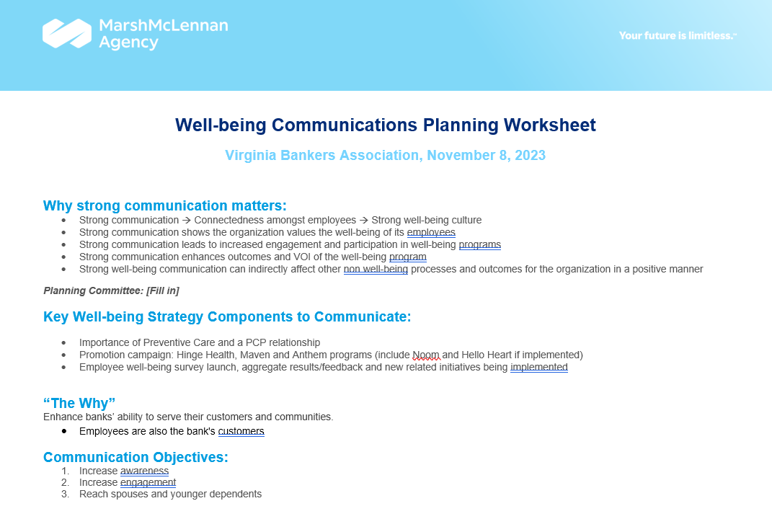
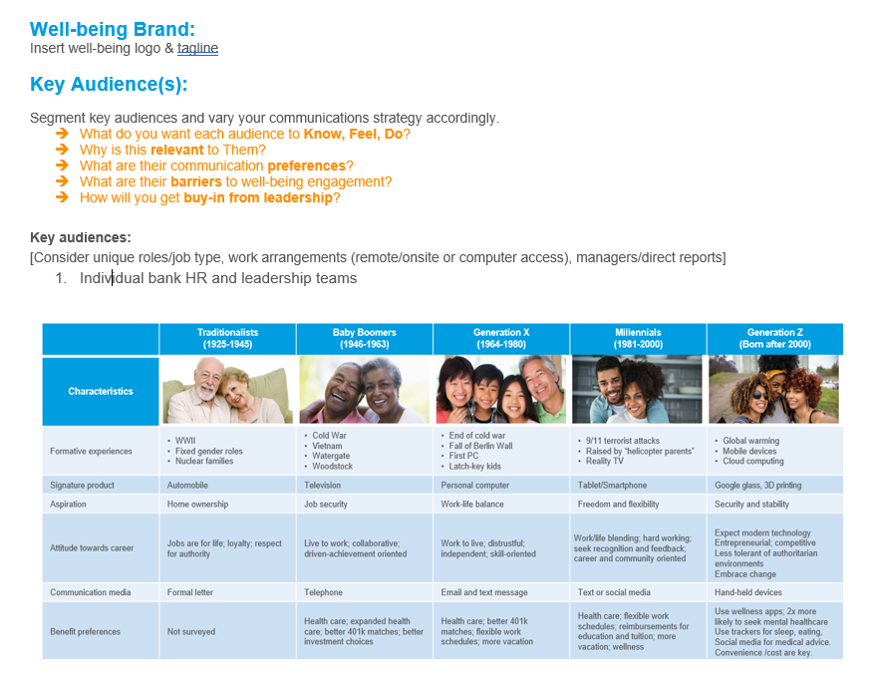

Slide 26
