Slide 1
Proposed weight management Solution

Slide 2
2024 data-driven Recommendations
Weight and
Hypertension/Blood Pressure
Management
Weight: LiveHealth Online vs. WW / Noom
BP: LiveHealth Online vs. Hello Heart
Fertility
and
Pelvic Health
Maven via Anthem
Hinge Health Pelvic Floor program via Anthem
Cancer Support Services
Anthem Cancer Concierge program
Johns Hopkins’ WorkStrides program
Hypertension: 1452
Hyperlipidemia: 425
Diabetes: 749
METABOLIC SYNDROME
WOMEN’S HEALTH
CANCER

Slide 3
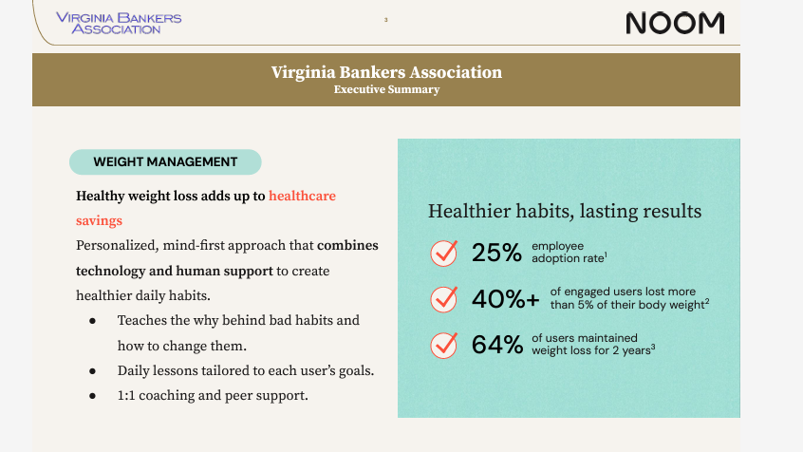

Slide 5
Noom’s story

Slide 6
Next steps
Present to VBA Benefits Corp. Board on February 23rd.
Launch a pilot program with 100 licenses available to Benefits Corp. population.
If pilot successful, roll out to population in 1/1/2025, building cost into renewal.

