Slide 1
VBA Retirement Conference
May 10, 2023

Slide 2
Administrative Support
1
Attrition
3
Expansion
Experienced unexpected attrition beginning in 2020.
Expanded our talent pool to include additional back-office support to assist with complex processing
2
Approach to staffing
4
Case loads
Adjusted our talent acquisition strategy to plan for growth and attrition
Right sized the book of business supported by plan management professionals
2

Slide 3
Employee Experience

Slide 4
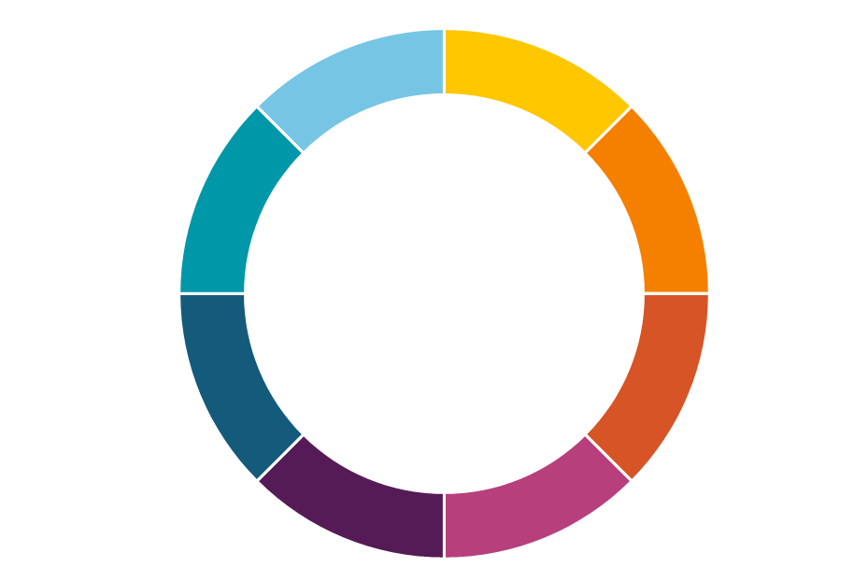
Hyper-personalization fueled by data and AI
Mandatory
Multi-channel experience
200 data points
Optimized by data, insights and science
The Voya Behavioral Finance Institute for Innovation
+
1 As of 09/30/2021.
For plan sponsor/TPA/financial professional use only. Not for use with participants.
CN2587845_1124
Notes:
We enable hyper personal financial care by focusing on three key areas:
The first is data, what we know about individuals. Its important to have the right data and ensure it is connected so we can talk to the whole customer. We utilize advanced data techniques to effectively utilize data at the source allowing us to bring internal and external data together and eliminating data silos. Our hybrid cloud approach allows us to effectively use both public and private clouds. This provides us maximum flexibility to scale our platforms to meet peak customer demand, while offering an agile infrastructure to help development teams maximize their productivity.
The second component is our predictive analytics engine. Voya’s model utilizes machine learning as a form of artificial intelligence to engage individuals with the right message at the right time. Our data is refreshed nightly and identifies if an individual has taken an action against the prescriptive message and removes it, or if newly identified, displays it. We access over 200 data points including plan features, balance, what in plan services the employee is utilizing and savings rates.
The third component is the experience. Our digital experiences utilizes our data and predictive analytics model to deliver targeted messages for each individual. Messages include e targeted based on the data we have for the individual and formats include text, email, video, website alert and call center message. Our experiences are optimized by data, science and insights as part of our Behavioral Finance Institute.

Slide 5
Our experience will help employees …
Get engaged
Save more
Feel confident
Our personalized email campaigns have a 2-3x higher engagement rate than standard email campaigns¹
Employees engaging in our personalized
Financial Wellness experience save 75% more²
76% of employees
feel confident knowing what steps to take after engaging with us³
1 Voya data as of 08/23/2022.
2.Voya Internal data s of 9/30/22
3 Voya survey data as of 09/30/22.
For plan sponsor/TPA/financial professional use only. Not for use with participants.
CN2587845_1124
Notes:
So what does that mean for your employees? Our approach delivers improved outcomes with employees that are more engaged, better saved and more confident in their future.

Slide 6
Employee experience
Mandatory
+ Voya enroll
Caregiver resources
Enrollment
& education
+ Voya Learn
+ Virtual and onsite
+ myOrangeMoney
+ Financial wellness experience
Customer service
Account access
+ Loan guidance
+ Personalized Video
+ Voya Retire app
+
+ In-plan advisory services
Advice + guidance
Communications
+ Plan communications
+ Personalized messaging
External accounts
For plan sponsor/TPA/financial professional use only. Not for use with participants.
CN2651150_0125

Slide 7
ADMASTER-STAMP!20230418-2822561-9035910
2023 Consumer Education Calendar
Help individuals gain control over their whole financial life with specific actions and helpful resources so they can feel confident and prepared today and in the future.
Q1 | Q2 | Q3 | Q4
Get organized and set goals Start the year fresh with an intentional plan aligned to your goals Understand your finances Create a budget Maximize your savings | Create your action plan Implement strategies to prioritize your personal financial care Evaluate your investments Manage your debt Put coverage to use | Prepare for the unexpected Be ready regardless of what life throws your way Emergency savings Evaluate protection needs Understand family implications | Focus on your future self Check in on your plan and re-prioritize your financial future Retirement savings Visualize healthcare needs Revisit and refine

Slide 8
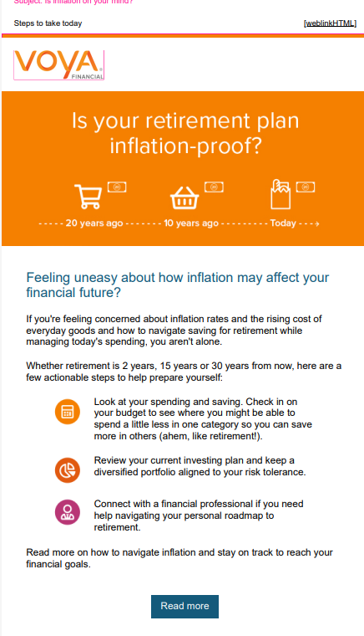
Q1 2023 Content Hubs
 | Articles | Video | Learning pods | Live sessions
Jan | Budgeting post Recession proof your finances | Setting financial goals Creating a budget Establish emergency savings | Steps to organize your spending and saving Steps to understand investing and the market | Get organized and on track Savers Tax Credit
Feb | Black History Month celebration article Inflation and your money Beneficiaries post | Prioritizing debt Strategies to save more Financial accounts and beneficiaries | Steps to manage your debt Steps when you are starting in the workforce | Financial tips when you are starting out Get organized and on track
Mar | International Women’s Month celebration article | Retirement planning for women Investing 301 Personal finances and family | Steps to set your financial goals Steps to plan for your future | Financial tips when you are starting out Establish good spending and savings habits
Start the year fresh with an intentional plan aligned to your goals
Understand your finances
Create a budget
Maximize your savings
America Saves Week – Feb 27
Black History Month
International Women’s Month
eDelivery campaign
Inflation campaign
VS.

Slide 9
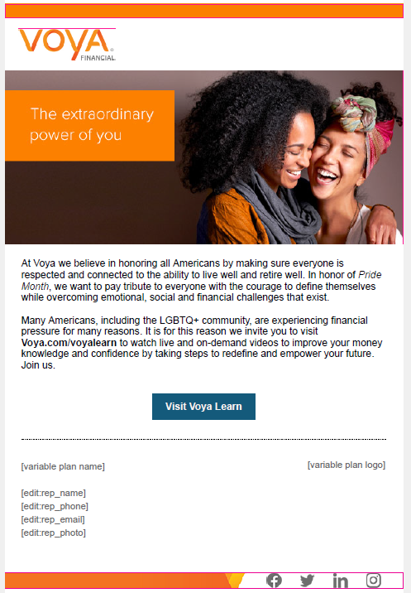
ADMASTER-STAMP!20230418-2822561-9035910
Q2 2023 Content Hubs
 | Articles | Video | Learning pods | Live sessions
Apr | Tax strategies Navigating market volatility Financial Literacy | Saving strategies for your family Addressing Uncertainty: Asset allocation Financial literacy | Steps to investing Steps to improve your financial literacy | 6 Tips for spring cleaning your finances Investing 101
May | Investing Mental health & finances Estate planning | Investing 101 Prioritizing debt Types of insurance Protect your finances with an estate plan | Steps to protect yourself today and in the future Steps to balance your priorities Steps to manage your debt | 6 Tips for spring cleaning your finances Investing 201
June | Pride article Health Savings Account Financial planning for your family Connecting health & wealth benefits | Investing 201 Nearing retirement Beneficiaries Health Savings Account | Steps to set other financial goals Steps to establish an emergency fund | 6 Tips for a mid-year check in on your finances Set and achieve other financial goals
Implement strategies to prioritize your personal financial care
Evaluate your investments
Manage your debt
Put coverage to use
Financial Literacy Month
Asian Pacific Islander Heritage Month
Pride Month
Diversify campaign
VS.

Slide 10
ADMASTER-STAMP!20230418-2822561-9035910
DEI Campaigns
May – June 2023
Asian Pacific Islander Heritage Month
Pride Month​
Voya is celebrating and paying tribute to generations of Asians and Pacific Islanders who have enriched America’s history and who are instrumental in our future.
This Pride Month, we are encouraging everyone to take Pride in who they are. Join us as we celebrate the LBGTQ+ Community and discover ways we can all achieve our financial goals.

Slide 11
Personalized messaging
Diversification
Advice
Multi-channel
Restart Savings
Save More
Phone call
Website
In-person
Beneficiary
Mobile App
Email
Text nudge
Happy Birthday
Health Savings Account
2-3x higher engagement rates than standard email campaigns¹
Quarterly Education
Personalized video
1 Voya data as of 08/23/2022.
For plan sponsor/TPA/financial professional use only. Not for use with participants.
CN2587845_1124
Notes:
Our multi channel approach allows us to deliver the right message at the right time to the right individual. We meet your employees where they are, whether it be through our call center, web experience app, text or email.

Slide 12
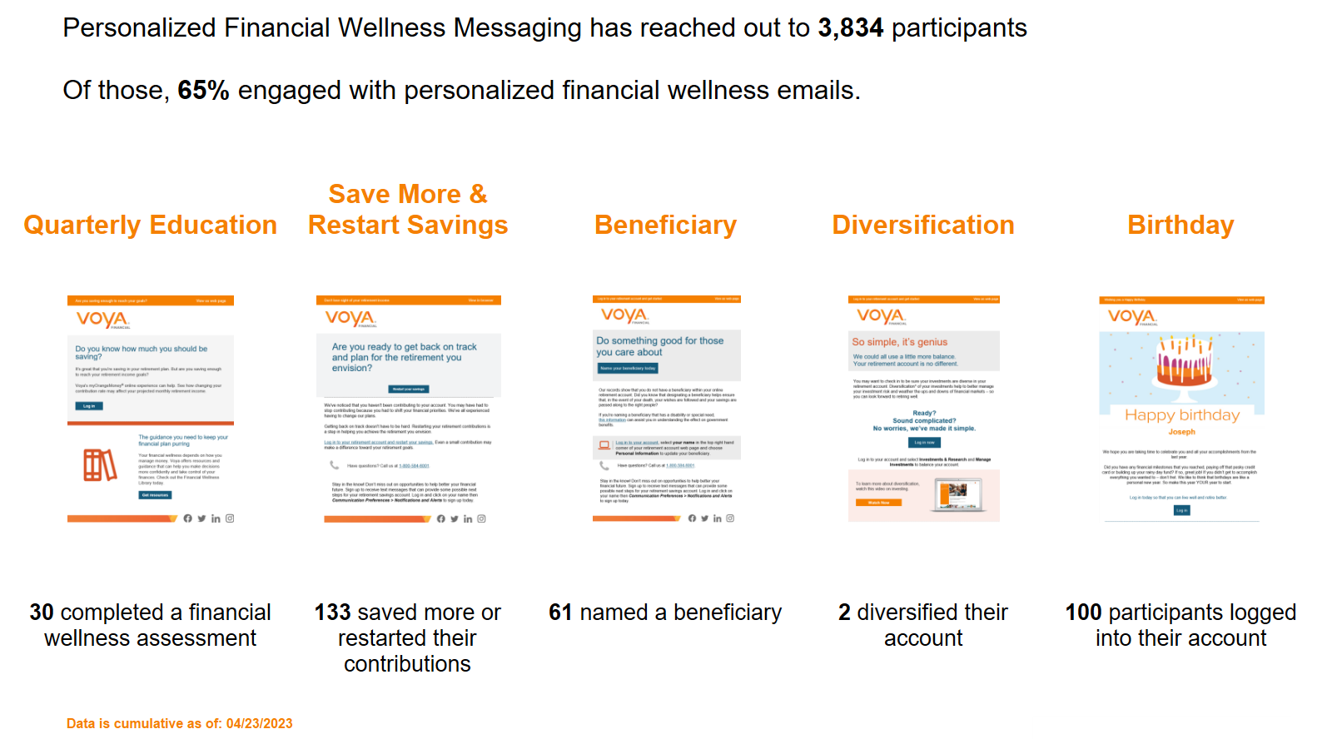
Personalized Messaging

Slide 13
Plan Utilization

Slide 14
2022 In Review
Quarterly Education for All Member Banks
Basics of Investing
Advanced Investing
Social Security
Health Care Costs in Retirement
Plan Document Restatement Completed
Reduction in Cost to Vanguard TDFs
Implemented Advisor Managed Accounts
Three New Plans Transferred to SBA
Electronic Delivery of Participant Fee Disclosure
Notes:
Targeted campaigns and required notices will need to be edited/moved based on timeframe or when they’re going to be executed
This might be the slide that plan sponsors print out to see what they have planned

Slide 15
Plan Health 2020 - 2022
 | 2020 | 2021 | 2022
# of Participant Accounts | 3,599 | 4,362 | 4,811
Average Income Replacement | 65% | 68% | 68%
Income Replacement 70% or Higher | 35% | 38% | 39%
Average Balance | $69,545 | $75,402 | $59,237
E-Delivery | 24% | 47% | 67%
Web Registration | 40% | 65% | 68%
myOrangeMoney % Engaged / % Took Action | 60% / 14% | 48% / 19% | 41% / 18%

Slide 16
Engagement

Slide 17
Income Replacement

Slide 18
Digital Engagement Summary

Slide 19
myOrangeMoney Engagement

Slide 20
Engagement Outcomes

Slide 21
Engagement Outcomes

Slide 22
2023 Overview
Objectives | Important Tasks & Reminders
Education for All Member Bank Participants Retirement Goals Over 40 – March 28 Retirement Goals Under 40 – April 26 Social Security Basics – June 21 Nearing Retirement – September 28 Estate Planning - December 12 Education for All Member Bank Sponsors – July Two Fund Changes – September SECURE ACT 2.0 Adaptation | 5500 & Audit Voya Files Extension Automatically Uncashed Checks Small Balance Force Out Discretionary Amendments by October 15
Notes:
Targeted campaigns and required notices will need to be edited/moved based on timeframe or when they’re going to be executed
This might be the slide that plan sponsors print out to see what they have planned

Slide 23
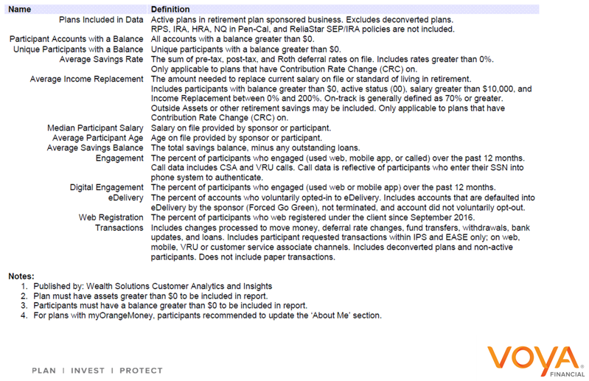
Definitions

