Slide 1
Let’s take amazing care of our hearts
Februrary 7, 2024
Hello Heart is a member of American Heart Association's Innovators’ Network

Slide 2
Healthcare costs continue to skyrocket.
And your members still struggle with their health.
My claim costs
keep rising.
My current programs aren’t being used.
Notes:
Purpose: Establish rapport & empathy
Talking Points:
The last few years have been been crazy!
COVID - accelerated digital HC
Hybrid work model constantly changing
DEI initiatives creating more priorities
Too many vendors in market to keep up with
M&A activity in HC
You know digital health solutions are the future but so much noise = tough to make sense of it
We understand your challenges

Slide 3
Address these challenges with a digital solution that delivers immediate value
Leading employers across all industries have implemented Hello Heart to reduce costs and improve outcomes
Notes:
Purpose: Why Go with a Focused Solution (General Logo Slide)
Talking Points:
Other employers just like you are focused on the conditions that affect the most people and drive the most cost
They are choosing to invest in programs that do one thing well
Demanding proof that things work
These are some of the employers that have decided to focus on heart health and partner with Hello Heart

Slide 4
Why do you need to focus on heart health?
#1
in prevalence
56%
have high blood pressure
and/or high cholesterol
#1
cause of death
690,000
deaths caused by heart disease per year
#1
most expensive chronic disease
$12.6k/year
total medical cost per individual with CVD
Notes:
Purpose: Establish heart disease as a top concern for benefit leaders
Talking Points:
Heart conditions and disease take the #1 spot: #1 prevalence, #1 unmanaged risk, #1 cause of death, #1 most expensive chronic disease
Suggested Question: Have you or a loved one been impacted by heart disease? Or have you seen the clinical impact of heart disease in your population?
Heart disease is the top clinical concern for your members:
High BP and cholesterol are literally at the heart of many chronic diseases
High blood pressure effects 48% of U.S., and high cholesterol effects 38%
Hypertension and high cholesterol (i.e., hyperlipidemia) are known as silent killers because they have no symptoms
Women are up to 2x more likely than men to die from complications of a heart attack
Trips to the doctor start with a BP reading
This clinical burden leads to high costs
Over $12K/year per person.
The average cost of a bypass surgery is over $150,000.
1 in 7 stents are unnecessary. The average cost of a stent procedure is $32,000 so that adds up.
Cardiac care is sadly rife with fraud, waste, and abuse.
Suggested Question: Is CVD one of your top 3 or 5 healthcare costs?

Slide 5
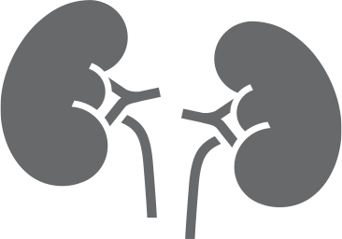
Heart health impacts more than the cardiovascular system
Dementia
Stroke
Thyroid
Vision Loss
Blood Clot
Sleep Apnea
Heart Attack
Heart Failure
Kidney Disease/Failure
Peripheral Vascular Disease
Sexual Dysfunction
Notes:
Slide Summary: Provide supporting evidence re: the need to focus on heart health management
Talking Points:
The basic underlying problem is build up in the arteries, which can lead to heart attacks and strokes
But there are other impacts as well
Poor heart health impacts more than just the cardiovascular system.
It can also play a role in the health of other important body systems and the development of chronic diseases that impact your healthcare spending like:
Sleep apnea
Renal disease
Mental and behavioral health

Slide 6
When you take care of your heart, amazing things happen
Notes:
Purpose: There Is a Better Way (showing the new way)
Talking Points:
There is a solution to the heart health problem
Hello Heart is completely focused on solving it

Slide 7
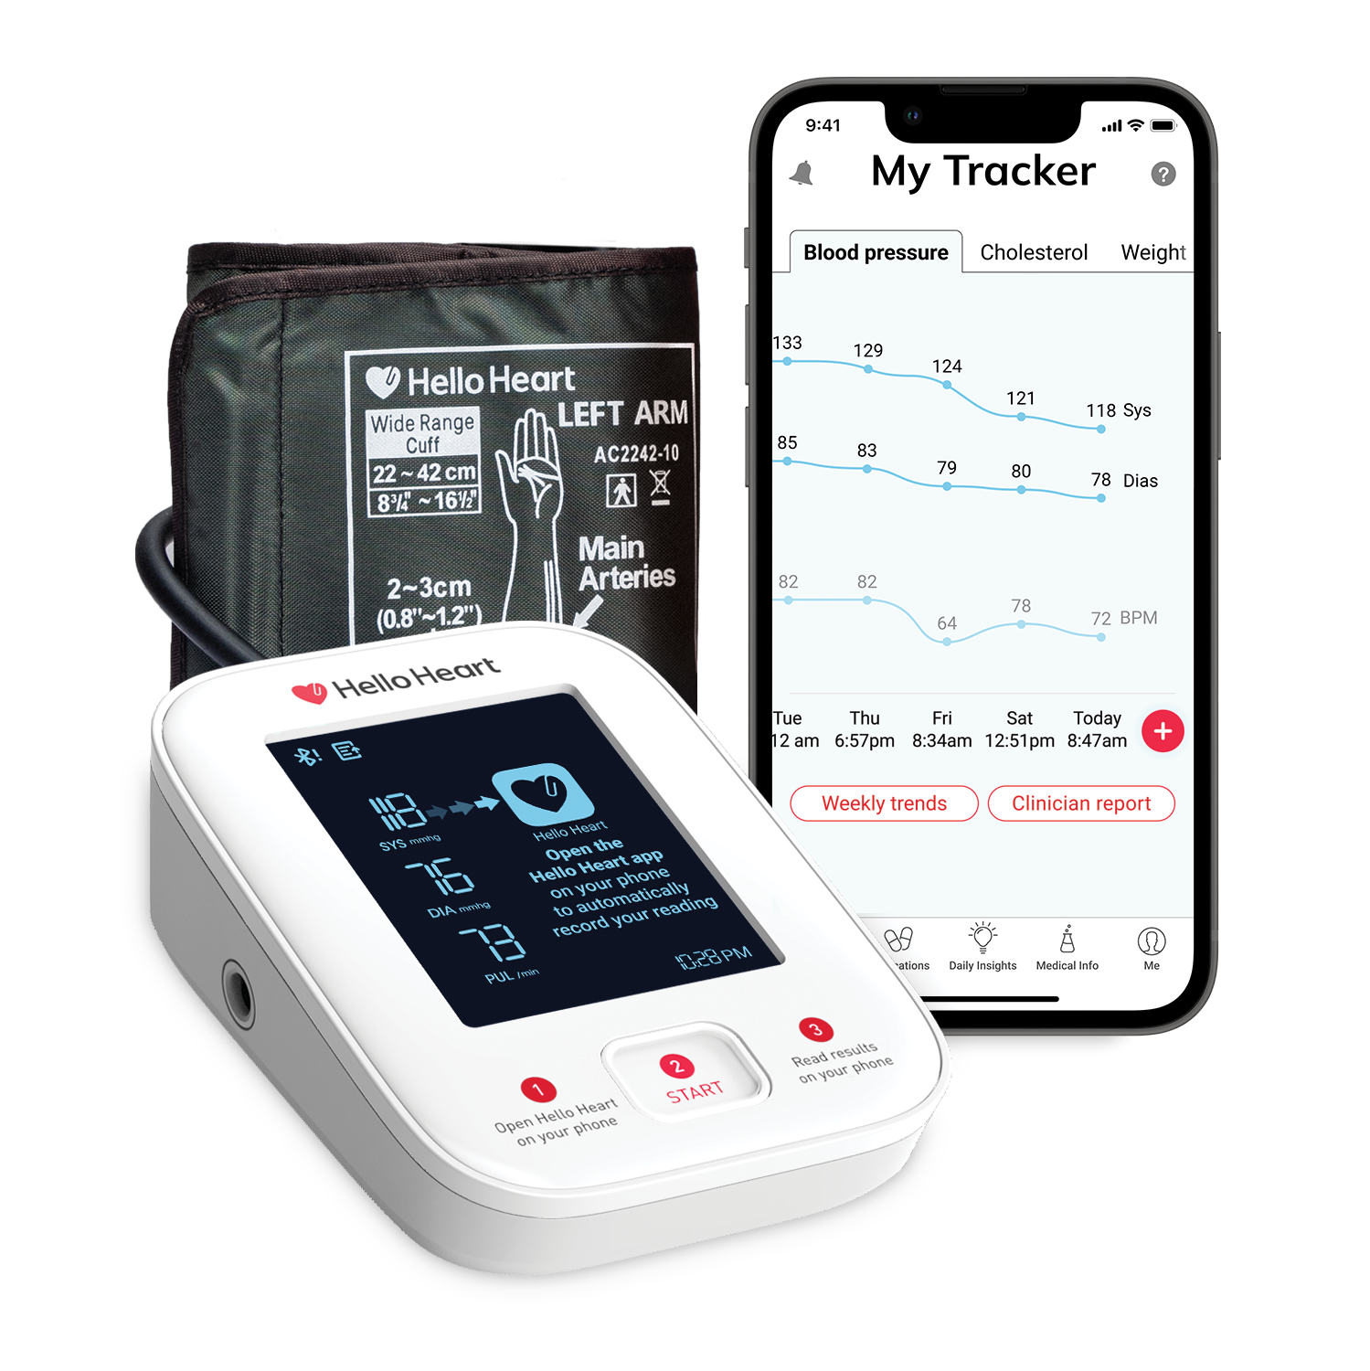
Hello Heart is the digital leader in preventive heart health
We address the major healthcare trends impacting employers through a best-in-class digital solution
High blood pressure
High cholesterol
Heart flags
Women’s heart health
Notes:
Purpose: Describe the solution at a high level - EMPLOYER VERSION
Talking Points:
Holistic heart health strategy must include:
Hypertension Management
Cholesterol Tracking
The cardiovascular system includes the pump (the heart) and the pipes (the blood vessels).
While a bad pump can lead to heart attacks and heart failure, bad pipes can lead to problems with organs beyond the CV system (e.g., the brain aka stroke, vision loss, kidney failure)
Manage the “pumps” and “pipes” in one spot
Heart Flags
Help users identify abnormal heart markers and respond
With Heart Flags, users can :
Catch abnormal heart markers, such as hypertensive crisis-level BP readings and irregular heartbeats
Understand what the reading means based on clinical guidelines
Decide what to do next (In some cases, this could include going to the ER. In other cases, no action is needed. The app can refer to your nurse line or health clinic.)
Women’s Heart Health
The program includes gender-specific user flows
Women’s unique heart attack symptoms and cholesterol ranges (HDL) are featured in the app
Support for menopause

Slide 8
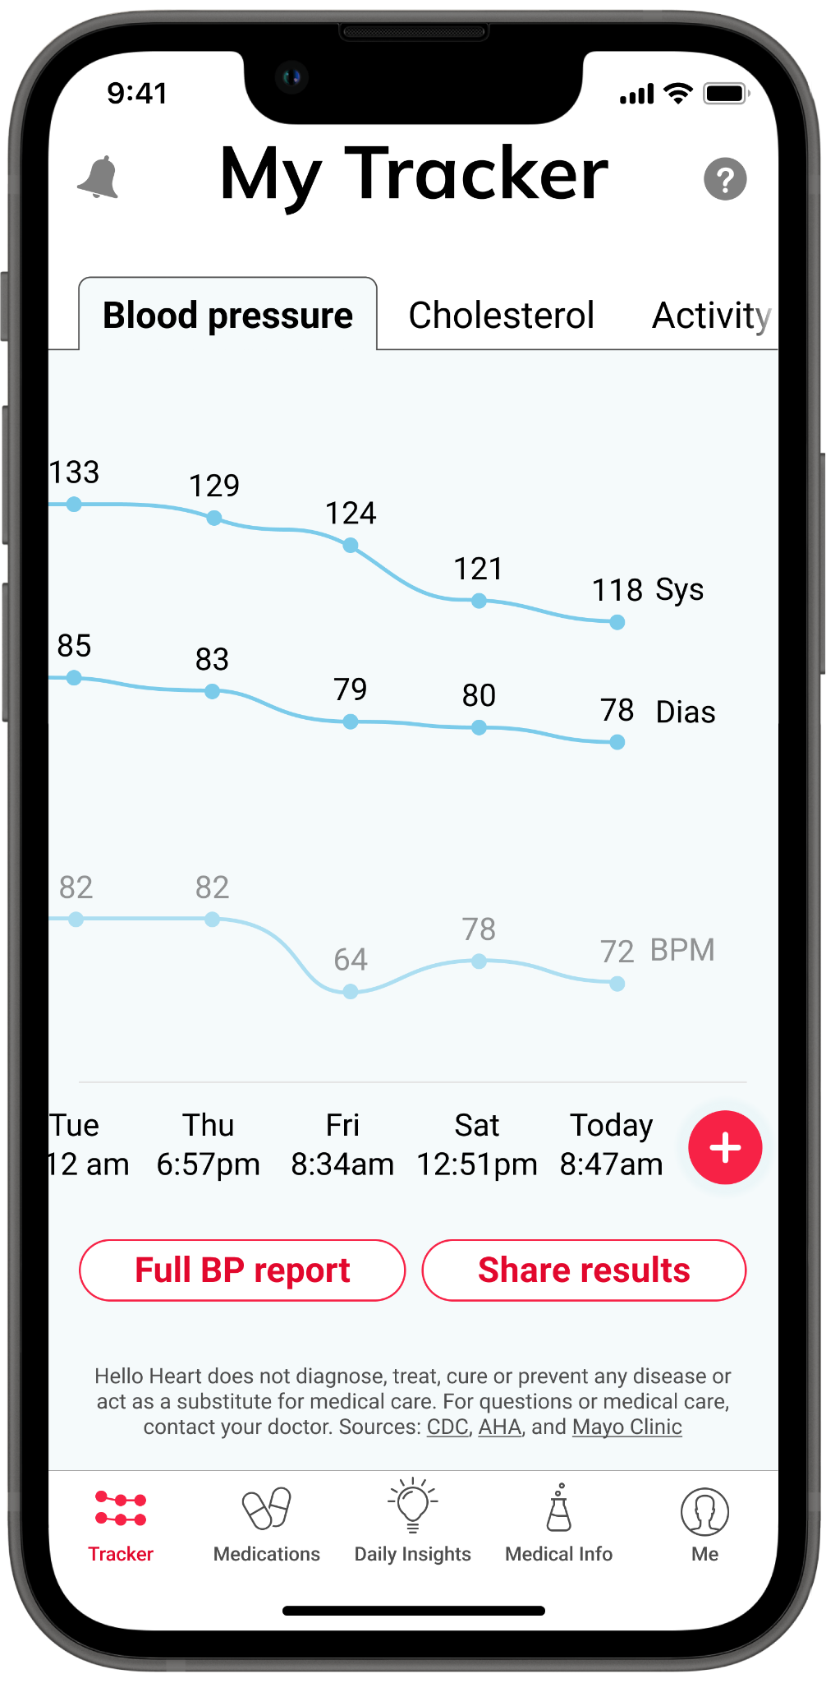
Hello Heart makes it simple to build a lasting heart habit
Simple by design. Easy to use.
Tracking of blood pressure, cholesterol, medication, activity, and weight
Detection of irregularities in blood pressure and pulse
Digital Coaching personalized with AI
Reporting shareable with physicians
Health equity and women’s heart health
Notes:
We are in the business of helping drive behavior change. Users receive our Hello Heart monitor, which syncs via bluetooth to your smartphone. And it’s within the app that the magic happens.
Users are easily able to track their blood pressure on a regular basis and receive insights into what those numbers actually mean.
They can pull in their cholesterol numbers and track their medications in a fun gamified way. We sync with Google Fit and Apple Health and pull in all that information to make a nice seamless experience. Over time, users will begin to see how each of these factors impact one another.
We detect irregularities in blood pressure and pulse specific to the individual. So let’s say there’s high blood pressure reading where it is likely something catastrophic will happen like a heart attack or a stroke. If this happens, we walk the user through a few action steps. Maybe they forgot to take their medication or they did the reading incorrectly, but we help them understand the next best step in care. And if it is truly that high, we can direct them to another benefit within your ecosystem like a nurse line or telemedicine.
We provide digital coaching driven by AI and we are very intentional about that. We know that people are more comfortable and consistent with health coaching when it’s convenient doesn’t feel intrusive. The app is available 24/7 and the coaching is unique to each user’s health, gender, geographic region as well as what they like and dislike in the app. Basically, we know the only way to get people to change their behavior is by having them enjoy what they're doing. So making sure the content is engaging and useful is what keeps people coming back on a regular basis.
We curate this information into reports that users can easily send to their doctors via email or fax or they can just share it in the doctor’s office–eliminating the headache of trying to track things on paper
And our app is DEI by design. I mentioned the women's heart health component. We know that women are two times more likely to die of a heart attack than men because our symptoms differ. So we make sure we call out those signs and symptoms that are gender specific.
And no matter how rural the population, because we are fully digital, users can access us anywhere. So we break down those barriers within traditional health care.

Slide 9
Lower blood pressure, cholesterol, and weight. Amazing.
Proven
Blood pressure
Cholesterol
Obesity
21
avg. reduction in systolic BP over 3 years for members with baseline over 140/90¹
67
12
avg. reduction in weight over 7.2 months for members with baseline obese BMI²
avg.reduction in LDL over 13 months for members with baseline high LDL²
mmHg
mg/dL
lbs
1. Gazit T, et al. JAMA Netw Open. 2021; 4(10). (Some study authors are employed by Hello Heart. Due to study design, causal conclusions cannot be made. 108 participants with baseline blood pressure over 140/90 were enrolled in program for 3 years and had application activity during weeks 148-163. Mean BP reduction reported was seen in the 84% of those who had any reduction at all. See additional study limitations in the publication.)
2. Based on internal data analyzed by Hello Heart. Not yet subject to peer review. Due to study design, causal conclusions cannot be drawn. (NOTE: Decrease in LDL seen in 80% of elevated LDL group (LDL≥160 mg/dL). Weight loss seen in 64% of sample with obese BMI (BMI ≥30 kg/m2) who lost weight.)
Notes:
Purpose: Highlight our leading outcomes
Talking Points:
Blood Pressure - Longest term and largest participant digital health study ever conducted 30k particpants over 3 years.
Over 84% of participants with stage II hypertension achieved a reduction in their systolic blood pressure and sustained it for up to 3 years
For participants with stage II hypertension that we tracked over three years, the average reduction in mean systolic blood pressure was 21 mmHg – Double any other published results
A peer-reviewed study* shows that the reduction of 10 mmHg systolic equates to 20% reduction in risk of major CVD events, 17% reduction in coronary heart disease, 27% reduction in stroke, and 28% reduction in heart failure
Study published in top tier medical journal in the fall of 2021 (peer reviewed and independent)
Longest term and largest participant digital health study ever conducted
Cholesterol and Obesity - We are about to release the results over our cholesterol study in another peer review journal. What is showed is that with those individuals with high LDL (or bad cholesterol) 80% of users reduced it over 13 months with the average reduction at 67 points.
And while we are not a weight lost program, we have seen a halo effect which makes sense right? So users with a baseline obese BMI saw an average weight reduction of 12 lbs over 7.2 months.
These results will be published in late 2023 or early 2024
Cholesterol results: Among patients with baseline high LDL , 80% reduced LDL with a mean reduction of 67 mg/dL.
Prior literature has shown that for each 38.7-mg/dL reduction in LDL-C, there was a 23% reduction in major vascular events, which included cardiovascular deaths, heart attacks, and strokes
Weight results: In participants with obese BMI (≥ 30 kg/m) at baseline, 64.0% reduced weight with a mean reduction of 12.0 (SEM 0.3) lbs
DATA DETAILS
Cholesterol
Data Background: Results are from a subset of 1,837 Hello Heart members enrolled from January 2018 – December 2022 and for whom we have at least 2 cholesterol test results that were at least 30 days apart. Median duration between the baseline and follow-up cholesterol test was 13 months.
Clinical Outcomes: Among patients with baseline high LDL (defined as ≥ 160 mg/dL), 79.8% reduced LDL with a mean reduction of 66.6 mg/dL. Prior literature has shown that for each 38.7-mg/dL reduction in LDL-C, there was a 23% reduction in major vascular events, which included cardiovascular deaths, heart attacks, and strokes
Weight
Data Background: Results are from a subset of XXX Hello Heart members enrolled from January 2018 – December 2022 and for whom we have … .
Clinical Outcomes: in participants with obese BMI (≥ 30 kg/m) at baseline, 64.0% reduced weight with a mean reduction of 12.0 (SEM 0.3) lbs

Slide 10
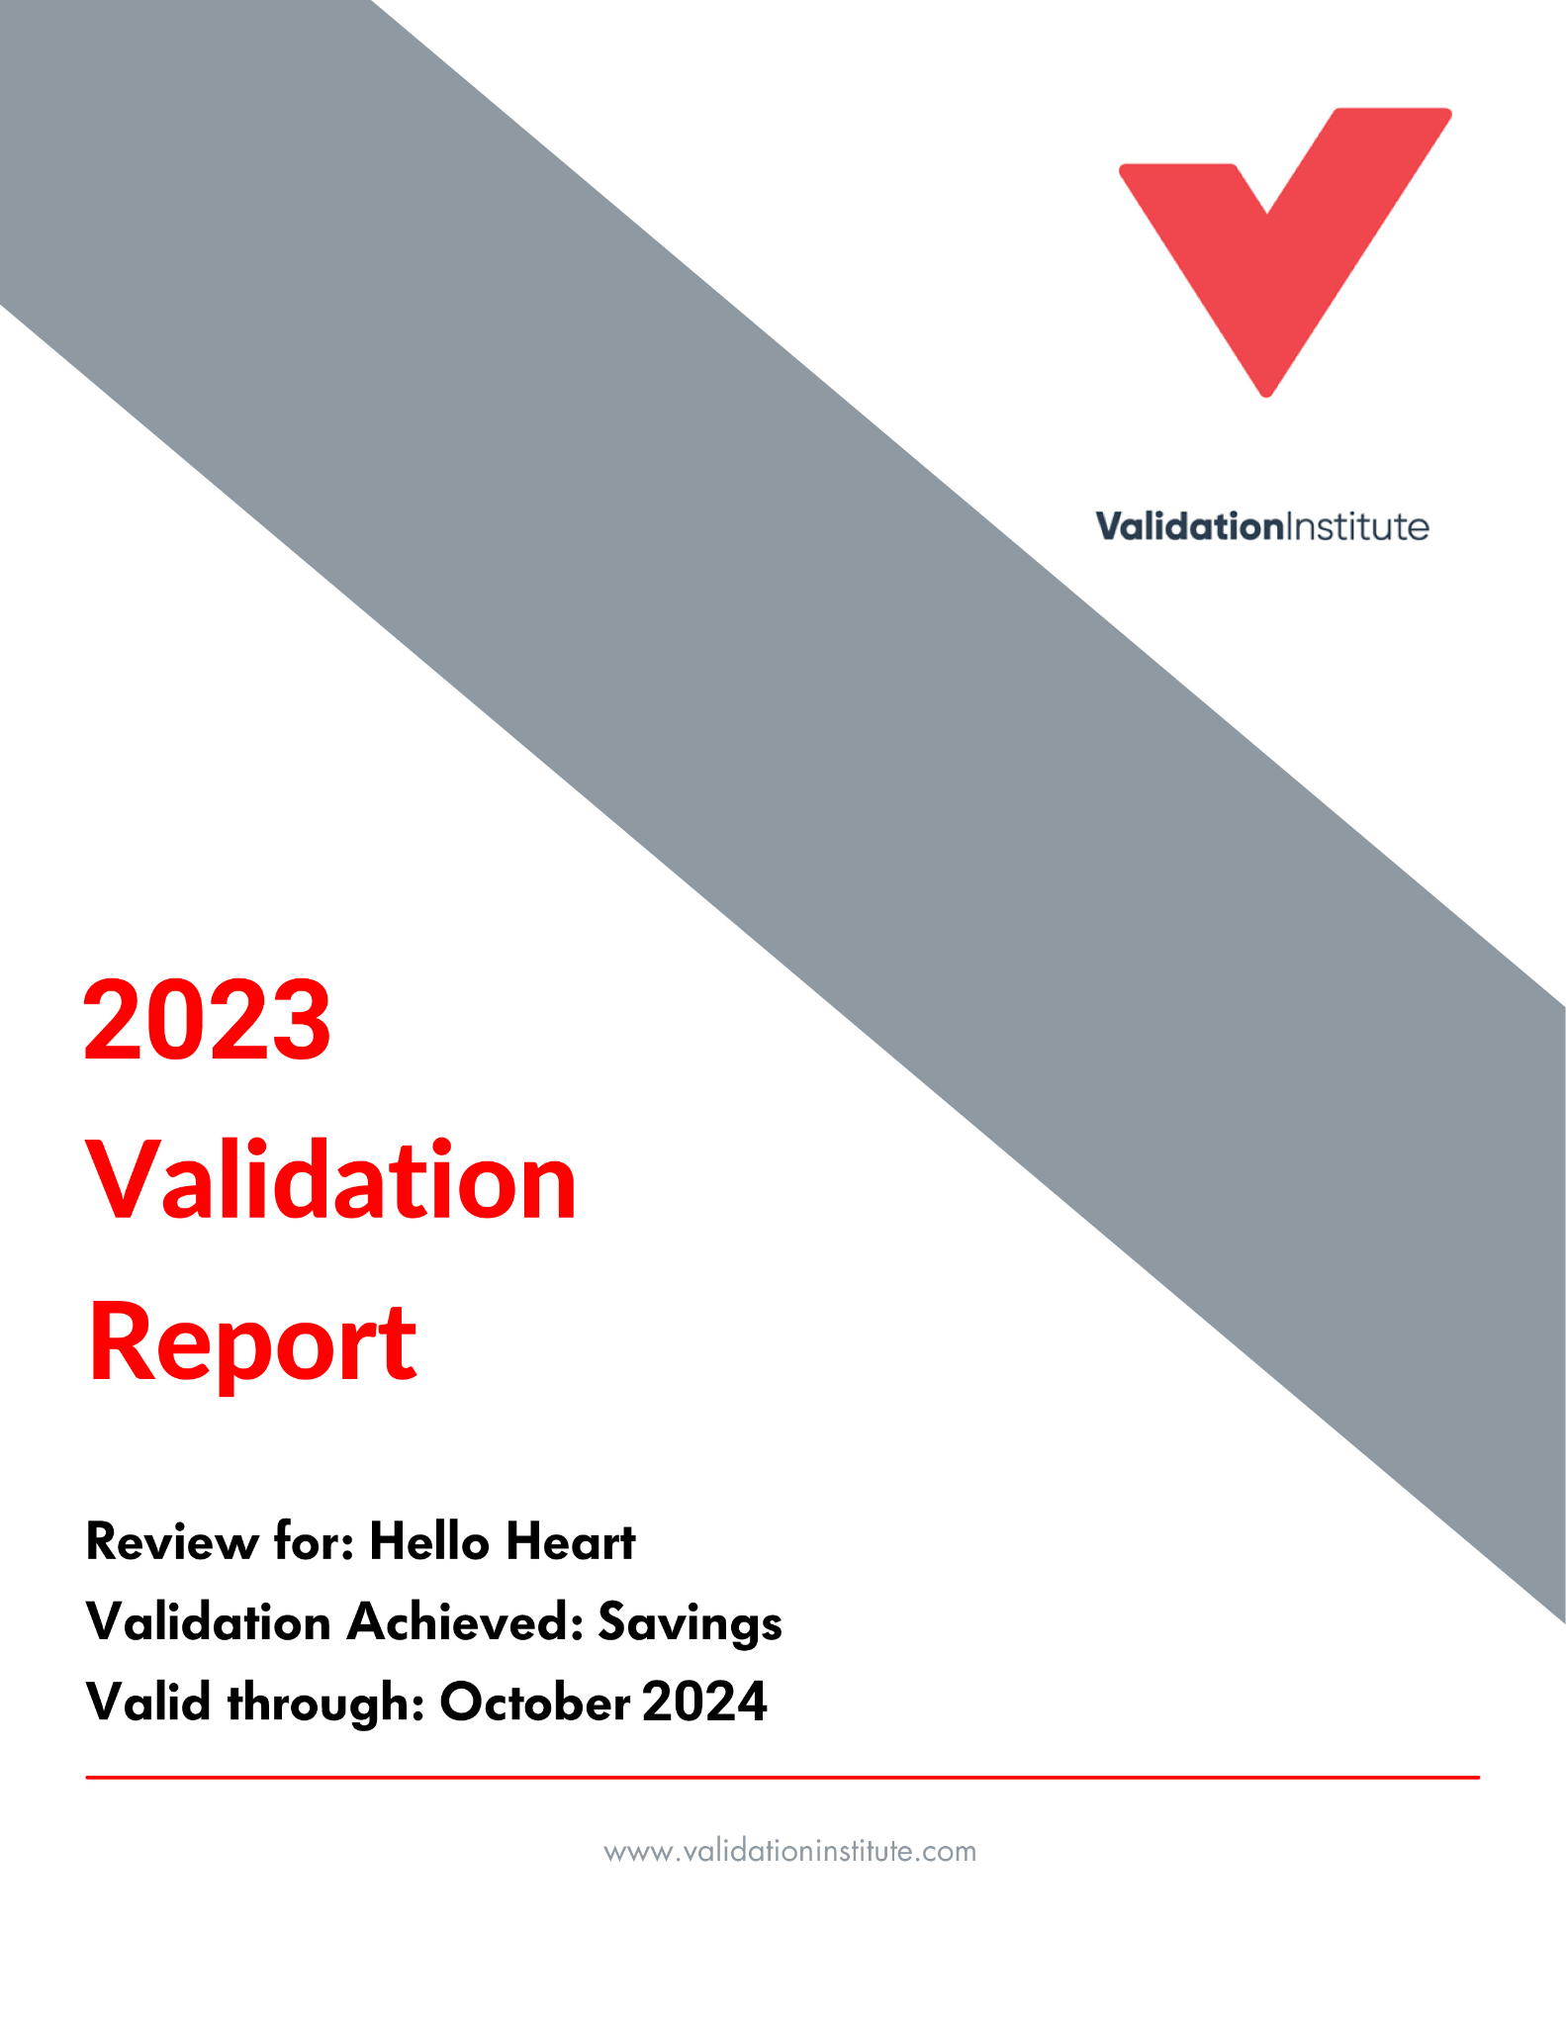
Report found 19% per member savings
Proven
ER visits
Hospital days
and admissions
$2,382
High-cost imaging
year 1 total medical costs reduction per participant¹
Primary Care Visits
¹ Validation Institute. 2023 Validation Report. https://validationinstitute.com/mp-files/hello_heart_savings_2023_final.pdf/. Published October 2023. Accessed November 1, 2023. (Analysis commissioned by Hello Heart. Report valid through Oct. 2024. Findings have not been subjected to peer review.)
Notes:
Purpose: Describe Differentiator: 3rd-Party Validated Cost Savings
Talking Points:
Validation Institute is a 3rd party that got its start helping GE and Intel measure ROI for their healthcare programs
They evaluated Hello Heart in 2021 and we received their highest level of validation for savings
Savings for Hello Heart were driven by fewer ER visits, 3 fewer days in hospital on average when admitted and fewer orders for high-cost imaging
A big positive was that primary care and prevention visits increased by 52% for Hello Heart users
Extra details for our EHS team:
Matched control study based on self-funded employer client medical claims data from 2017 to 2020
We achieved a Level 1 validation for Savings
Certifies that we can reduce healthcare spending per participant and/or for the client overall
Valid through October 2022
The certification = our savings are guaranteed
Other notable results
Users less likely to be hospitalized
Those that were admitted stayed for 3 fewer days on average
Spending on primary care and prevention visits increased by 52%
More proactive partnership with doctors to manage their condition over time
VALUE PROP RECAP
These two studies will help you justify your decision and give you confidence that you are buying the best

Slide 11
Members love the Hello Heart experience
Engaging
Instant insights
Blood pressure
Oct 13
Steve! B
Personalized
This app has really helped me keeping track of all my medicine that I took or skipped. And being able to show blood pressure to the doctor. It gives you useful advice daily.
Positive
Simple
Notes:
Purpose: “Why” Users Love
Talking Points:
“We ask our users what they love about Hello Heart, and this is what we hear from them…”
An all-digital solution
Available 24/7
Removes barriers to access/inclusive
Don’t need to travel to an in-person clinic
Personalized to each member’s needs
A simple yet powerful example of personalization is how the product supports women’s needs (heart attack symptoms, as an example)
Private
We assure your employees that their data is theirs alone
Users have total control over sharing or not
Easy and fun to use
Gamification that’s fun even for 50-year olds. Fun is one of the most frequently used words we hear in user reviews.
Always uplifting and positive (never judgmental)
Creates a habit of taking blood pressure and making behavior change

Slide 12
This positive experience leads to lasting habits
Engaging
High enrollment
Sustained engagement
20%
60%
enroll in year 1¹
continue after year 1¹
¹ Based on data on file at Hello Heart.
Notes:
Purpose: Reinforce our High Enrollment and Engagement
Talking Points:
Our clients are amazed by our enrollment and engagement rates!
ENROLLMENT
Our rates are:
Approximately 20% enrollment rate after the Year 1
More than 40% enrollment rate after Year 3(ONLY MENTION IF ASKED)
The average traditional blood pressure program’s have low single digit enrollment rates.
ENGAGEMENT
Our rates are:
More than 60% of users continue after the first year (engagement rate)
Nearly 75% engagement rate after the first 3 years (ONLY MENTION IF ASKED)
The average traditional blood pressure programs have much lower sustained engagement rates.
VP RECAP
Your people will actually use our program, leading to improved population health

Slide 13
DIFFERENTIATOR SUMMARY/CLOSING SLIDE
Why Hello Heart?
Engaging
Proven
Easy
20% enrollment of eligible population¹
60% are still active after 1 year¹
$2,382 potential cost savings per participant in Year 1²
21 mmHg avg. systolic blood pressure reduction observed over 3 years by those with Stage 2 hypertension³
Seamless partnership through partner ecosystem
Simple and easy-to-implement member onboarding program to drive enrollment
¹ Based on data on file at Hello Heart.
² Validation Institute. 2023 Validation Report. https://validationinstitute.com/mp-files/hello_heart_savings_2023_final.pdf/. Published October 2023. Accessed November 1, 2023. (Analysis commissioned by Hello Heart. Report valid through Oct. 2024. Findings have not been subjected to peer review.)
² Gazit T, et al. Assessment of Hypertension Control Among Adults Participating in a Mobile Technology Blood Pressure Self-management Program. JAMA Netw Open. 2021; 4(10). (Some study authors are employed by Hello Heart. Because of the observational nature of the study, causal conclusions cannot be made. There were 108 participants with baseline blood pressure over 140/90 who had been enrolled in the program for 3 years and had application activity during weeks 148-163. See additional important study limitations in the publication.)
Notes:
Purpose: Summarize differentiators, repeat benefits, and share user and client proof
Key Talking Points:
ENGAGING: Our enrollment and engagement rates prove that your people will actually use our program, leading to a healthier population
NPS: +66¹
PROVEN: You can justify your decision with proven clinical outcomes and ROI
Proven clinical outcomes: 2X greater²
Validated financial outcomes: $2,382 reduction in year 1 total medical costs per participant³
EASY: You can focus on other priorities since we do all the heavy lifting
MORE PROOF: Client retention: 97%¹
Footnotes:
¹ Based on data on file at Hello Heart.
² Sources: (1) Gazit T, Gutman M, Beatty AL. Assessment of Hypertension Control Among Adults Participating in a Mobile Technology Blood Pressure Self-management Program. JAMA Netw Open. 2021;4(10):e2127008, https://doi.org/10.1001/jamanetworkopen.2021.27008. Accessed May 17, 2022. (Some study authors are employed by Hello Heart. Because of the observational nature of the study, causal conclusions cannot be made. See additional important study limitations in the publication. This study showed that 108 participants who had been enrolled in the program for 3 years and had application activity during weeks 148-163 were able to reduce their blood pressure by 21 mmHg using the Hello Heart program) (2) Livongo Health, Inc. Form S-1 Registration Statement. https://www.sec.gov/Archives/edgar/data/1639225/000119312519185159/d731249ds1.htm. Published June 28, 2019. Accessed May 17, 2022. (In a pilot study that lasted six weeks, individuals starting with a blood pressure of greater than 140/90 mmHg, on average, had a 10 mmHG reduction.) NOTE: This comparison is not based on a head-to-head study, and the difference in results may be due in part to different study protocols.
³ Validation Institute. 2022 Validation Report (Valid Through October 2023). https://validationinstitute.com/mp-files/hello_heart_savings_2022_final.pdf/. Published October 2022. Accessed November 1, 2022. (This analysis was commissioned by Hello Heart, which provided a summary report of self-funded employer client medical claims data for 203 Hello Heart users and 200 non-users from 2017-2020. Findings have not been subjected to peer review.)

Slide 14
Q&A
DANA JACKSON dana.jackson@helloheart.com
Citations available upon request.
Notes:
Purpose: Ask for Feedback and Clarify Next Steps
Comes down to: SAVING LIVES
Hello Heart is a member of the American Heart Association’s Innovators’ Network
Key Talking Points:
Feedback?
What parts of the presentation stood out to you?
What parts confused you?
Next Steps?
Do you want to continue our conversations? If yes, who else should we involve?
Would you like to do an Opportunity Analysis, go through a live demo and/or try for yourself?

Slide 15
Appendix Slides

Slide 16
Virginia Bankers Association
Kickoff
Notes:
Purpose: Introductions and Meeting Goals
Talking Points:
Introductions
Confirm meeting goals - Level set on attendees’ prior knowledge of HH
Reconfirm time available for attendees

Slide 17
Enrollment Process
Members register via text, website, or phone call
Hello Heart confirms program eligibility in two steps:
Member gets a link to download the Hello Heart application
Blood pressure monitor will be sent to the member’s home with instructions on how to connect the device to the app
Member must log in to app to receive monitor
Member self-attests to inclusion criteria on enrollment page
Eligibility data from Anthem will confirm they are a covered member
Notes:
Our goal is to make it as easy as possible for your users to enroll...we ask a few simple questions, we confirm if they are a covered member via the eligibility file, they receive a link to download the HH app, and their BP monitor is shipped to their home with easy to follow instructions on getting started.
Of course, our fantastic member support team is also available to assist with questions or setup
If asked about clinical criteria, [TBD]
If Asked about gating/self attestation inclusion criteria, our standard is as follows:
Updated gating questions:
I have high blood pressure (130/80+ [or as determined by client] or take medications for blood pressure)
I have high cholesterol (or take medications for cholesterol)
I am a woman aged 52+ or am going through or have gone through menopause
Someone in my close family (parent/sibling) has issues with heart disease/heart health
None of the above apply to me

Slide 18
Program Details
Launch Date
February 1, 2024
Eligibility
Employees and adult dependents covered by an Anthem medical plan
App Based Program
Members must have access to a smartphone to participate
Communication Strategy
Hello Heart-sponsored communication package to support ongoing participation

Slide 19
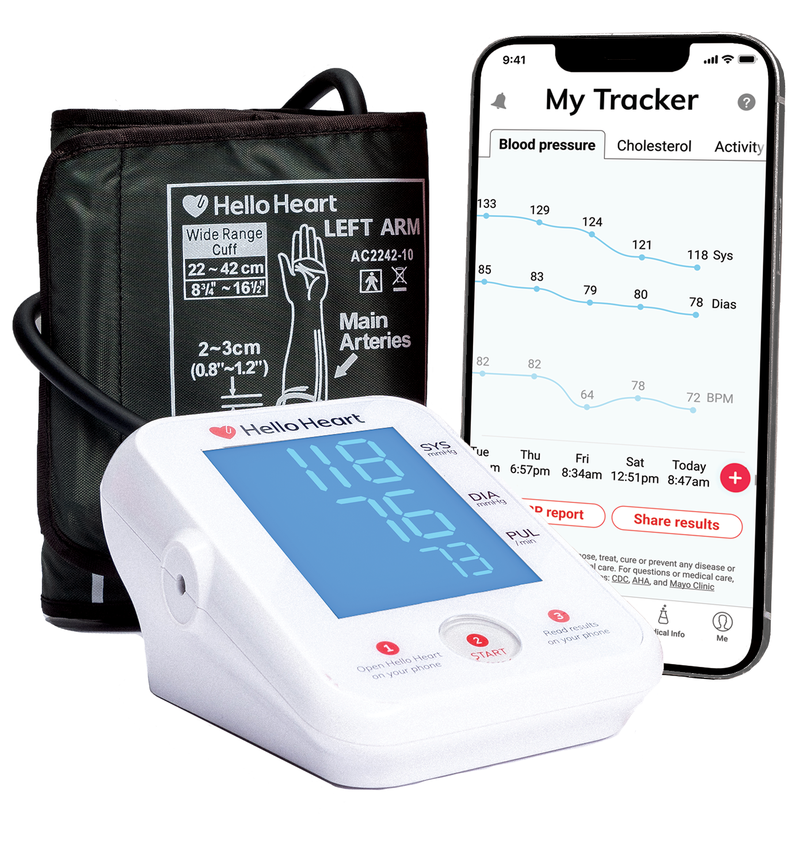
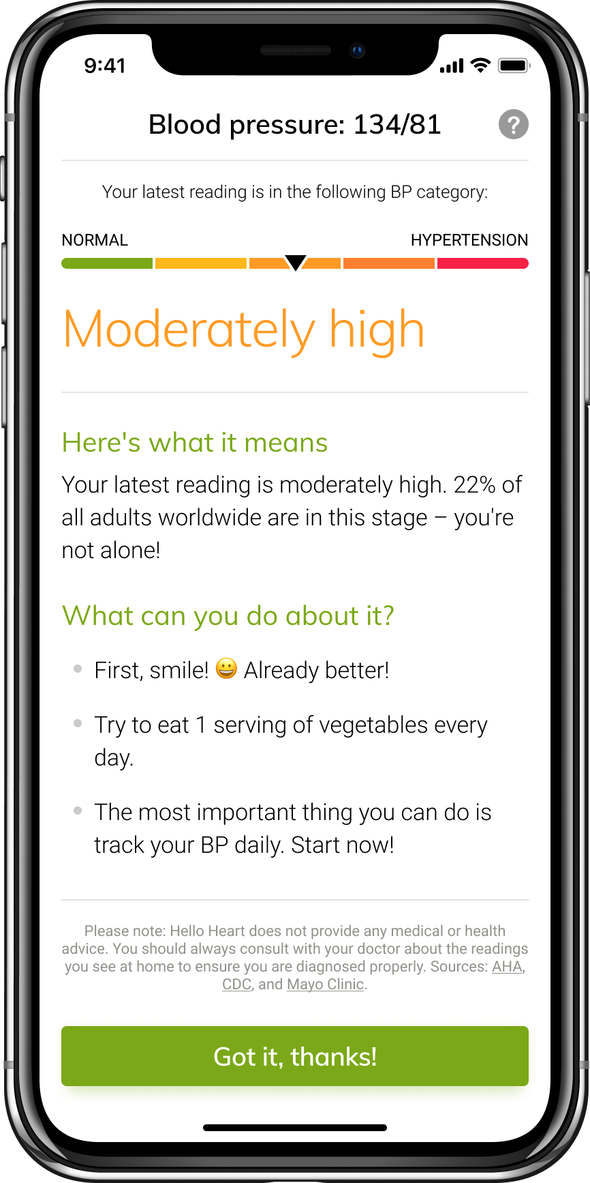
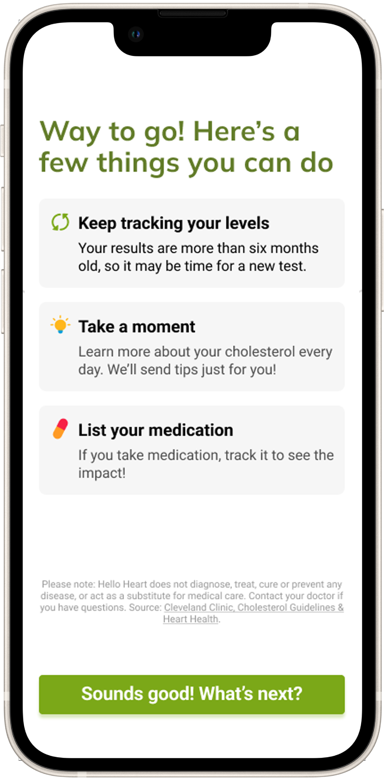
Ongoing Usage - Members Will:
Track
Understand
Control
Notes:
After a user enrolls in the program and they receive their monitor, they’ll be able to start tracking their blood pressure. As they track their BP, we provide them feedback on what their readings mean so they can understand their heart health. They’ll also have access to many features within the app that will help them manage their blood pressure, such as clinically based digital coaching tips, a medication adherence feature that allows them to track their medication, they can share reports with their doctor, and the app will also provide timely care guidance to users that have serious risk detected in their blood pressure readings.

Slide 20
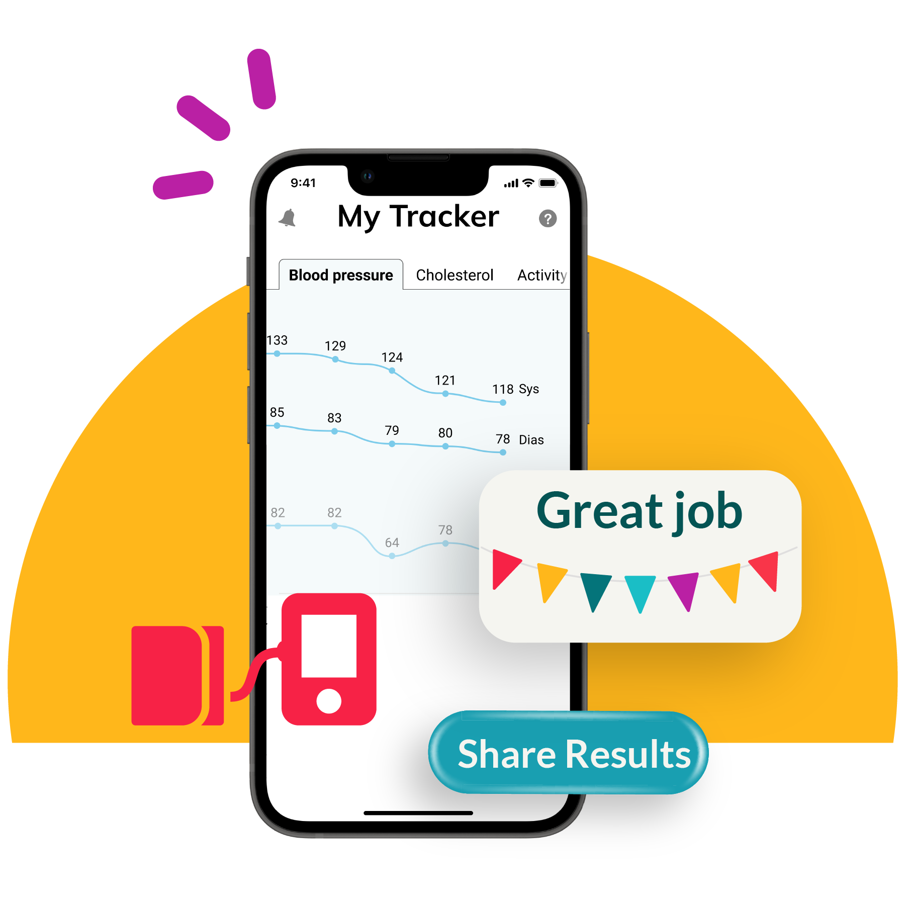
Engagement
Engagement campaigns embedded in the program:
Engagement and educational emails
AI driven nudges through email, in-app notifications, push notifications and text messages
Hello Heart sponsored sweepstakes throughout the year
Notes:
We want them to continue their progress, create healthy habits, and we strive to keep them engaged, Our goal is to help them improve their heart health and overall hypertension. We will send them nudges to continue to educate them, give them tips/tricks to creating a healthy lifefstyle, remind how their doing, and encourage them to continue to follow healthy habits they’ve created.
On top of the nudges and in-app notifications, we also have various other means of encouraging engagement within the app. We sponsor raffles or donations throughout the year to encourage continued use (ex: donation to AHA for taking your BP during heart health month; entry into raffle for yoga mat or $50 gift card for BP readings). Also, if you have any other wellness incentive programs that we can piggyback on and integrate with, we can include that as part of our ongoing communication. we’re happy to discuss setting that up.

Slide 21
Q&A
DANA JACKSON dana.jackson@helloheart.com
Citations available upon request.
Notes:
Purpose: Ask for Feedback and Clarify Next Steps
Comes down to: SAVING LIVES
Hello Heart is a member of the American Heart Association’s Innovators’ Network
Key Talking Points:
Feedback?
What parts of the presentation stood out to you?
What parts confused you?
Next Steps?
Do you want to continue our conversations? If yes, who else should we involve?
Would you like to do an Opportunity Analysis, go through a live demo and/or try for yourself?

