Slide 1
2024 WELLNESS SUMMIT
PRESENTED BY THE VBA BENEFITS CORPORATION & MMA
February 7, 2024

Slide 2
VBA Benefits Corporation and wellness: Background

Slide 3
Historical Wellness offerings: participation-based initiatives
Program parameters
results
Offered to banks until 2016.
Employers would offer various wellness programs and onsite screenings to employees.
Banks meeting minimum participation goals would receive a 1-2% premium reduction in renewal rates.
Programs included wellness challenges, screenings and health risk assessments.
Limited number of member banks participated year over year.
Results were not measurable; impact on members’ health or improvement on healthcare costs.
No long-term strategy or goals.
Benefits Corp. “owned” the program administration with limited staff resources.

Slide 4
Current wellbeing initiatives: path data analytics and population health management

Slide 5
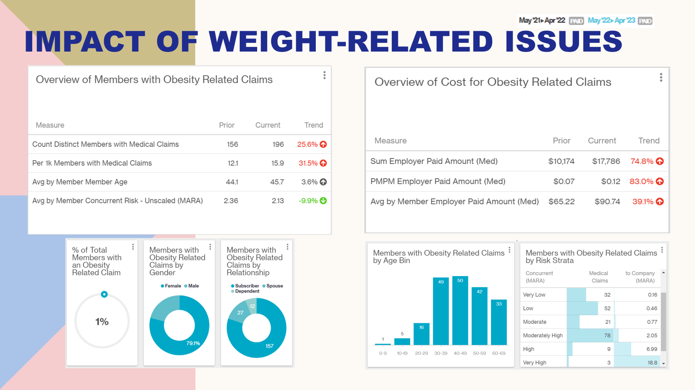
Clinical data analytics and population health management through MMA, effective 2017
Historical medical and pharmacy claims data repository
Tracks health plan cost management strategies
Partner with vendors to improve member engagement strategies
Mine data for recommendations specific to our population’s health claims cost drivers
Allows independent review of vendor reporting and performance standards and guarantees

Slide 6
2022-2023 PATH Executive Summary
Population Health
TOP 3 C HRONIC CONDITIONS:
BEHAVIORAL HEALTH
2085 members with BH condition
Acute and Chronic
59% employees
Top diagnoses
Anxiety and Mood Disorders
65% of all virtual visits were BH
PCP office visits and Admits increased in prevalence
Alcohol related disorders 2nd top Inpatient Admit diagnosis
RISK BANDS
Current Risk / Predicted Risk
1.27 / 1.27
Employees Spouses
1.46 / 1.50 1.72 / 1.78
Very low 6517 members ($334)
Low 3423 members (744)
Moderate 885 members ($1358)
Mod High 3591 members ($5549)
High 331 members ($38,165)
Very High 90 members ($114,783)
47%
Hypertension (1418)
of members have a chronic condition.
Lipoprotein Disorders(1089)
Anxiety ( 920)
CHRONIC CONDITION OVERVIEW
7012 members (2.5% decrease YoY)
68% Employees, 16% Spouses, 16% Dependents.
Hypertension: 1452 members; 79% Employees.
Hyperlipidemia: 524 members; 80% Employees.
Diabetes: 749 members; 75% Employees
88% Type 2 Diabetics.
Musculoskeletal (MSK): 3451 members; 27% of member population: 68% Employees
Chronic: 1629 members; 47% of member population: 73% employees
2nd highest spend over 3 years by diagnostic category.
PREVENTIVE CARE
47% had a preventive visit
46% in prior year
12% of members had no medical claims in current reporting period
Same as prior year
WELL-BEING PROGRAMS
Comprehensive well-being & condition management programs with optimal engagement to support behavior change can help shift members to lower risk bands and reduce cost. Shifting just 5 high risk members to moderately high risk could result in potentially significant annual savings.
* Metabolic Syndrome may occur when members have a cluster of chronic conditions that lead to progressive vascular conditions such as Diabetes, Coronary Artery Disease, Chronic Kidney Disease, End Stage Renal Disease, and Stroke.
Previous: May 2021 – April 2022
Current: May 2022 – April 2023
6

Slide 7
2022-2023 Data-driven action plan: population health examples of metabolic conditions and mental health
FOCUS AREA | CURRENT PROGRAMS | STRATEGIC OPPORTUNITY
Well-being Strategy 47% of members had a chronic condition; increase in prevalence 46% Preventive Care utilization; increase in prevalence 12% of members had zero medical claims in the current reporting period Risk of Metabolic Syndrome Increase in Hypertension, Hyperlipidemia, and Diabetes claimants Hypertension top PCP visit diagnosis Increase in Diabetes Rx Employer Paid Amount: $4M Decrease in Diabetes Medical Employer Paid Amount: $290k | Anthem LiveHealth Online virtual medical services 2022 utilization: 558 engaged: 442 Medical: 8 Dermatology: 4 Sleep: 105 BH Condition Care Management: Asthma, CAD, Heart Failure, COPD and Diabetes 2022 utilization: 1,739 identified Asthma – 784: CAD:173: Heart Failure: 23: COPD: 62: Diabetes: 697 Contact Rate: 28%: Enrolled of Contacted: 85%: Engaged of Enrolled: 84% | Well-being Cancer Support Develop communication campaign to promote available resources for those undergoing cancer treatment. Metabolic Syndrome Preventive Strategy Consider weight management point solution to help manage top chronic conditions: WW, Noom Hypertension Condition Management: Hello Heart, Anthem’s Healthy Impact Program: Blood Pressure and Weight Management: LiveHealth Online Lifestyle Accounts Promote American Heart’s Life Simple 7: the 7 risk factors that people can improve through lifestyle changes to help achieve ideal cardiovascular health: Complete Heart Assessment (https://www.heart.org/en/healthy-living/healthy-lifestyle/my-life-check--lifes-simple-7)
Mental and Behavioral Health Increase in trend Prevalent age bins 20-29 Anxiety and Mood Disorders top two diagnoses Alcohol-related disorders 2nd top Inpatient Admit diagnosis Increase in PCP visits and Admits Increase in Medical Employer Paid Amount = $2M | Anthem Live Health Online virtual services 2022 utilization: 105 BH EAP 2022 utilization: 286 total requests: 577 total contacts: 62.5% emotional:17% marital/child: 7% Family/Child issues | DE&I: Establish an Employee Resource Group – individual bank level Strengthens employee connections and builds internal support framework Allows forum for advocacy for internal resources www.usgs.gov/office-of-diversity-and-equal-opportunity/employee-resource-groups
7

Slide 8
2024 data-driven Recommendations under consideration
Weight and
Hypertension/Blood Pressure
Management
Weight: LiveHealth Online vs. WW / Noom
BP: LiveHealth Online vs. Hello Heart
Fertility
and
Pelvic Health
Maven via Anthem
Hinge Health Pelvic Floor program via Anthem
Cancer Support Services
Anthem Cancer Concierge program
Johns Hopkins’ WorkStrides program
METABOLIC SYNDROME
WOMEN’S HEALTH
CANCER
VBA offers the option to add Lifestyle Spending Accounts through FBA to support wellness or other concierge services (Bank Choice).
8

Slide 9
Looking forward: holistic wellbeing approach

Slide 10
Initiatives: Benefits Corp. and member employers
Communications and Educational Resources:
Turnkey wellness campaigns created by Anthem & VBABC
VBABC internal wellbeing resource site
Wellbeing solutions
Campaigns
Wellness Vendor Technology
Tools & Resources
Point Solutions
Point solutions:
Hinge Health – digital MSK solution (1/2022)
Maven – digital women’s health (1/2024)
Hello Heart – digital cardiovascular program (PILOT in 2024)
Noom – digital weight loss solution (potential PILOT in 2024)
Due Diligence in process:
MMA & VBABC interviewing four wellness technology platform firms to provide total wellness solution
Analyzing multiple approaches to partnership
Resources available through VBABC & MMA:
Laura Moore, MMA’s wellness consultant
eMMpower site
Wellbeing flipbook resource guide in process

Slide 11
Next steps
Create individual employer Multi-Year Wellbeing Strategy and meet with executive team.
Contact VBA Benefits Corp. with any specific needs/inquiries.
Attend mid-year “Wellbeing Summit Check-In” scheduled for May 16th at 1pm (virtual invite will be sent as follow-up).

Slide 12
Thank you!

