Slide 1
Wellbeing Survey Results
Survey Conducted January 2024 Among HR Administrators
VBA Benefits Corp

Slide 2
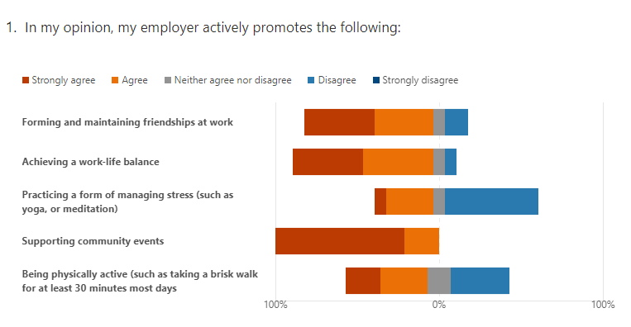
14 participants in survey

Slide 3
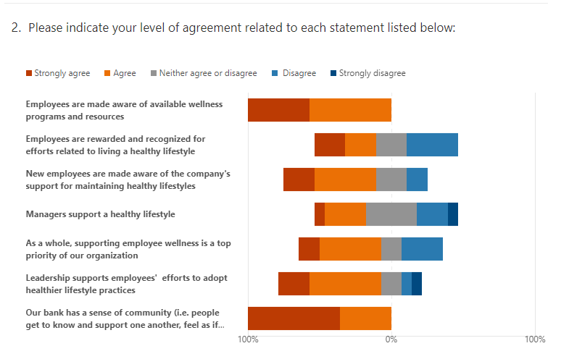

Slide 4
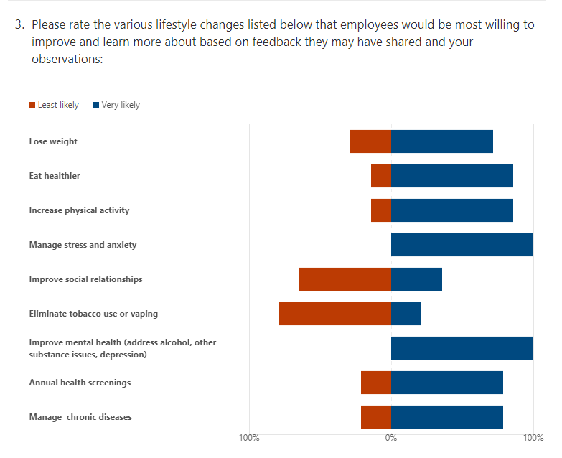

Slide 5
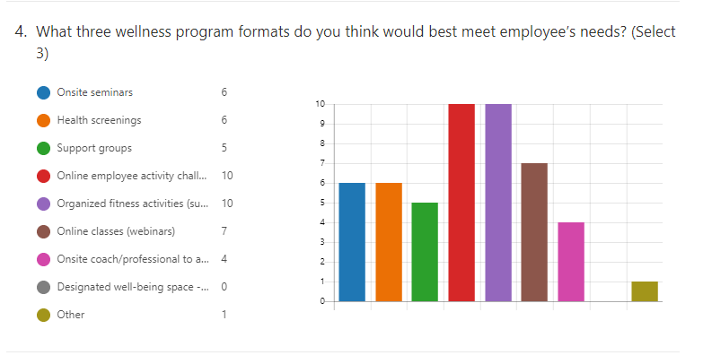

Slide 6
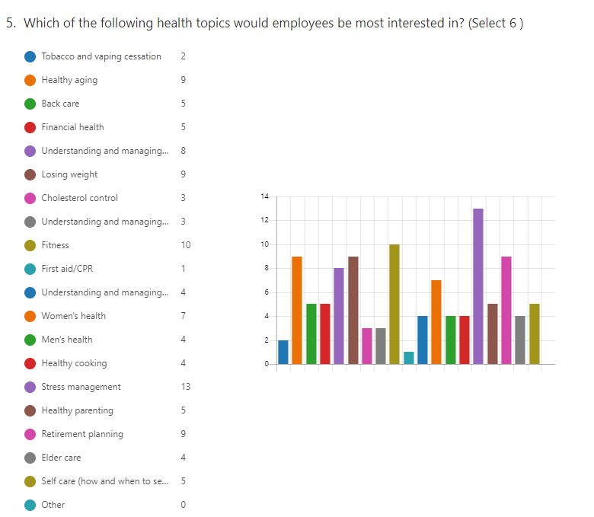

Slide 8
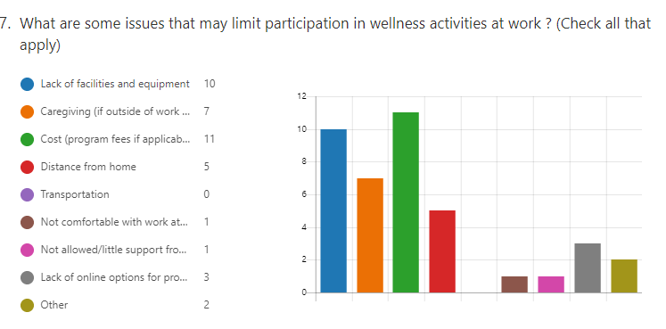

Slide 10
Next steps:
Conduct employee survey and learn what your employees think about wellbeing programs offered at your organization and their readiness to participate in programs.
VBA has provided a sample employee survey on the Wellbeing Microsite, customize based on your specific organization’s culture and needs.

Slide 11
Questions?

